Slide 1
Agenda for GEOG260/360 GIS & Land Change Models
September 13
Your brain will retain more when you hand write notes on paper than when you type notes.
If you cannot refrain from doing to do irrelevant or distracting things with electronic devices, then do not bring the devices to class.
See Geller announcement on slide 2.
We now have a class fileshare. See instructions on slide 3.
Get instructions for Assignment 2
Introduction to the Geomod land change allocation model in TerrSet
September 18
Discuss Assignment 2
Discuss Philosophies of Modeling
September 20
Assignment 2 by 4pm on Canvas
Get instructions for Assignment 3

Slide 2
Student Research Grant Opportunity
Announcing the 2024 Geller Endowed Research Awards
For student projects relating to sustainability
Undergraduate and graduate students
Grant awards up to $2500
Project period: January 2, 2024 to December 31, 2024
Application Deadline: Friday, October 27, 2023, 4:30pm
For more details:
https://www.clarku.edu/centers/marsh-institute/student-opportunities/geller-research-fellowships/

Slide 3
Mapping a File Share
Click here for directions to map on a Windows Device
Use \\fs.ad.clarku.edu\class\GEOG260-01-F23
Click here for directions to map on an Apple Device
Use cifs://fs.clarku.edu/class/GEOG260-01-F23

Slide 4
Assignment 2
Use data in ForestOtherBuilt2.zip from Canvas, which is the same data as for Assignment 1. Perform two runs of Geomod. For both runs, use 1985Built1 at 1985 as Beginning landuse image, 1985 as Beginning time, 1999 as ending time, 14 as time step, and do not do environmental impact analysis.
For first run, create parameter file called run1, use Mask, Neighborhood search mode constrained by width 3 by 3, 1 simulation, 1 driver with equal weights, Driver map as elevation02, use an extrapolation of the gross built gain during 1971-1985 to determine the simulated quantity at 1999, do not output interim time images, use run1 as prefix.
For second run, create parameter file called run2, use towns map as Strata, Neighborhood search mode unconstrained, 1 simulation, 4 drivers with equal weights, Driver maps as elevation02, geology, 1971 landuse 21 categories, protection, use 1999Built1 at 1999 as ending time landuse validation image to determine the quantity by town, do not output interim time images, use run2 as prefix.
For each model run, perform CROSSTAB to produce a map that shows the simulated changes from 1985. Submit one PPTX file that shows for each run the: driver map(s), Geomod’s suitability map, your CROSSTAB map that shows simulated changes. Include paragraphs that describe how Geomod computed the suitability values and explain where the largest suitability values are for each run. Also, describe the behavior of Geomod’s simulation and your assessment of validation.

Slide 5
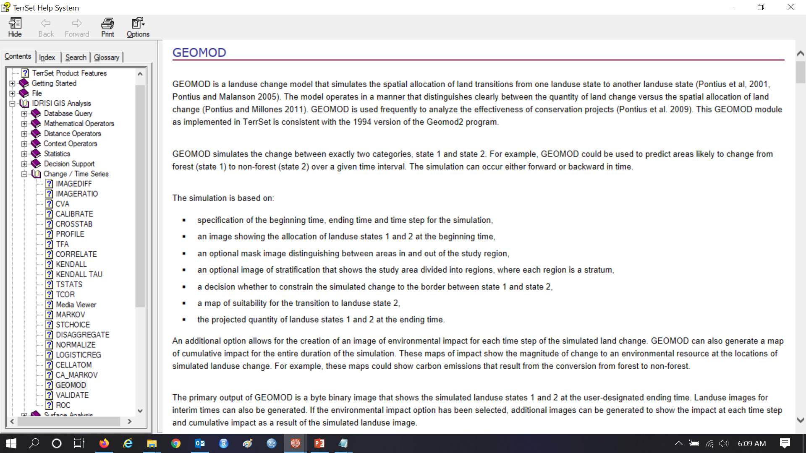
Read the Help for GEOMOD

Slide 6
Calibration interval for quantity is 1971-1985

Slide 7
How should we extrapolate quantity to 1999?

Slide 8
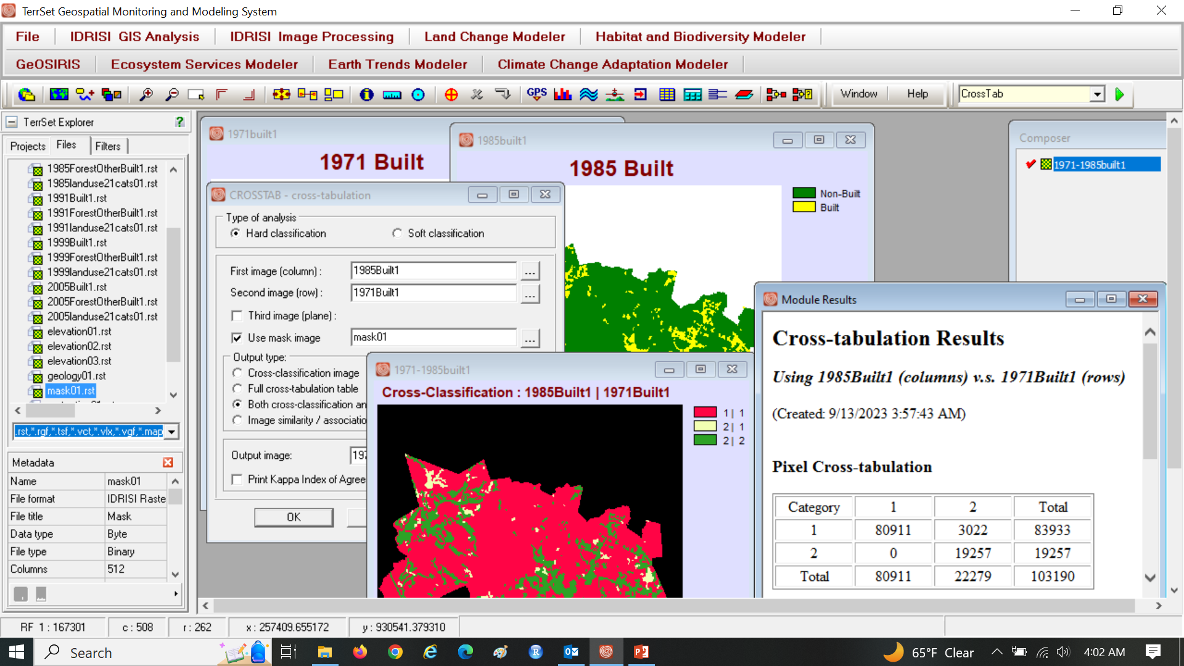
How many pixels of gross gain during 1971-1985?

Slide 9
There are 3022 pixels of gross gain during 1971-1985. How many pixels of gross gain should we extrapolate during 1985-1999?

Slide 10
Humans have concentrated building up to year 1985 on which elevations?

Slide 11
Humans have concentrated building up to year 1985 on which elevations?

Slide 12
Elevation must be in bins to compute for each elevation bin a ratio. What should that ratio be?

Slide 13
The method to bin from continuous elevation to binned elevation is subjective.

Slide 14
Read the Help for GEOMOD

Slide 15
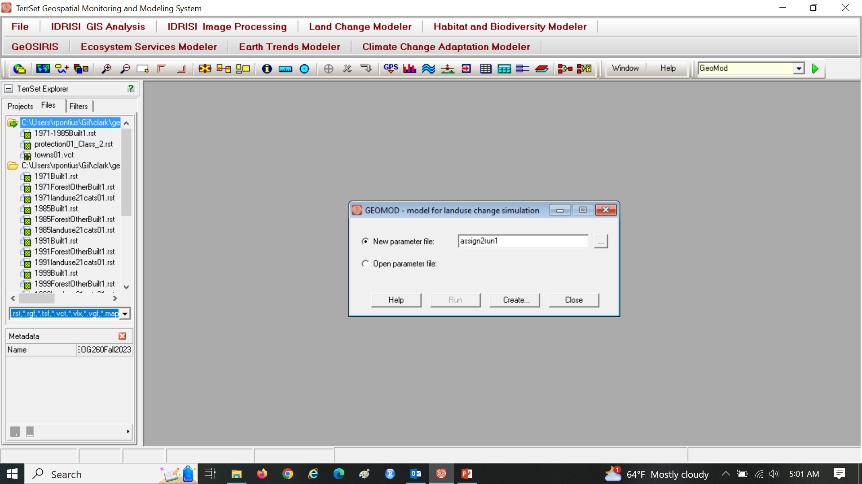
Assignment 2

Slide 16
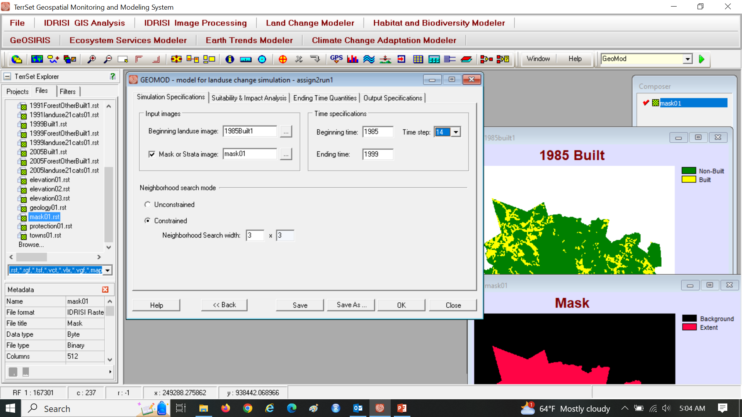
Geomod simulates one transition from category 1 to 2.

Slide 17
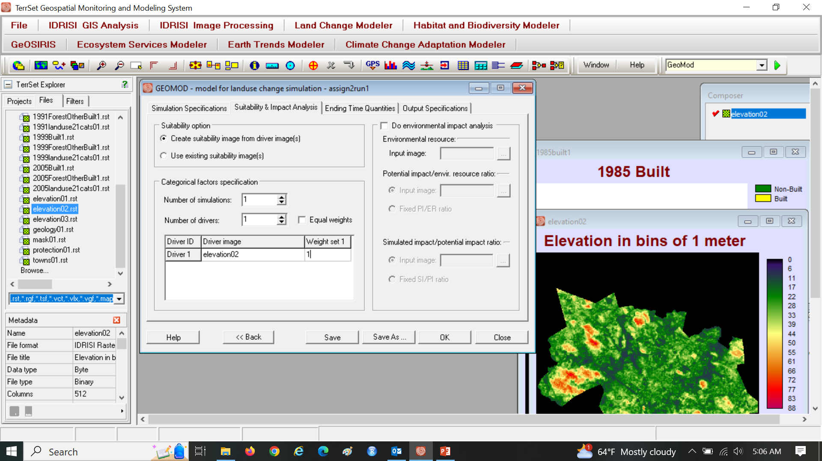
Use Elevation02 as the only Driver

Slide 18
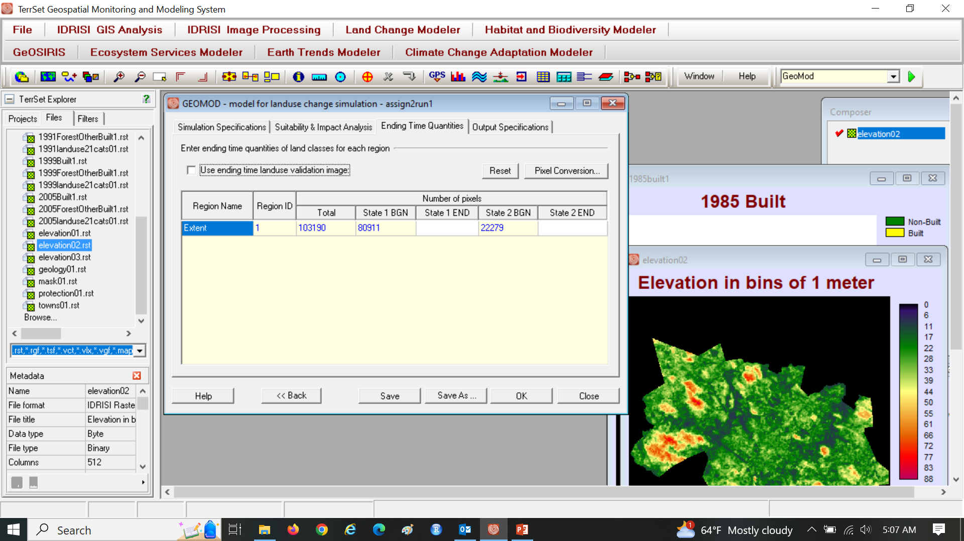
State 2 END is quantity of simulated Built at 1999

Slide 19
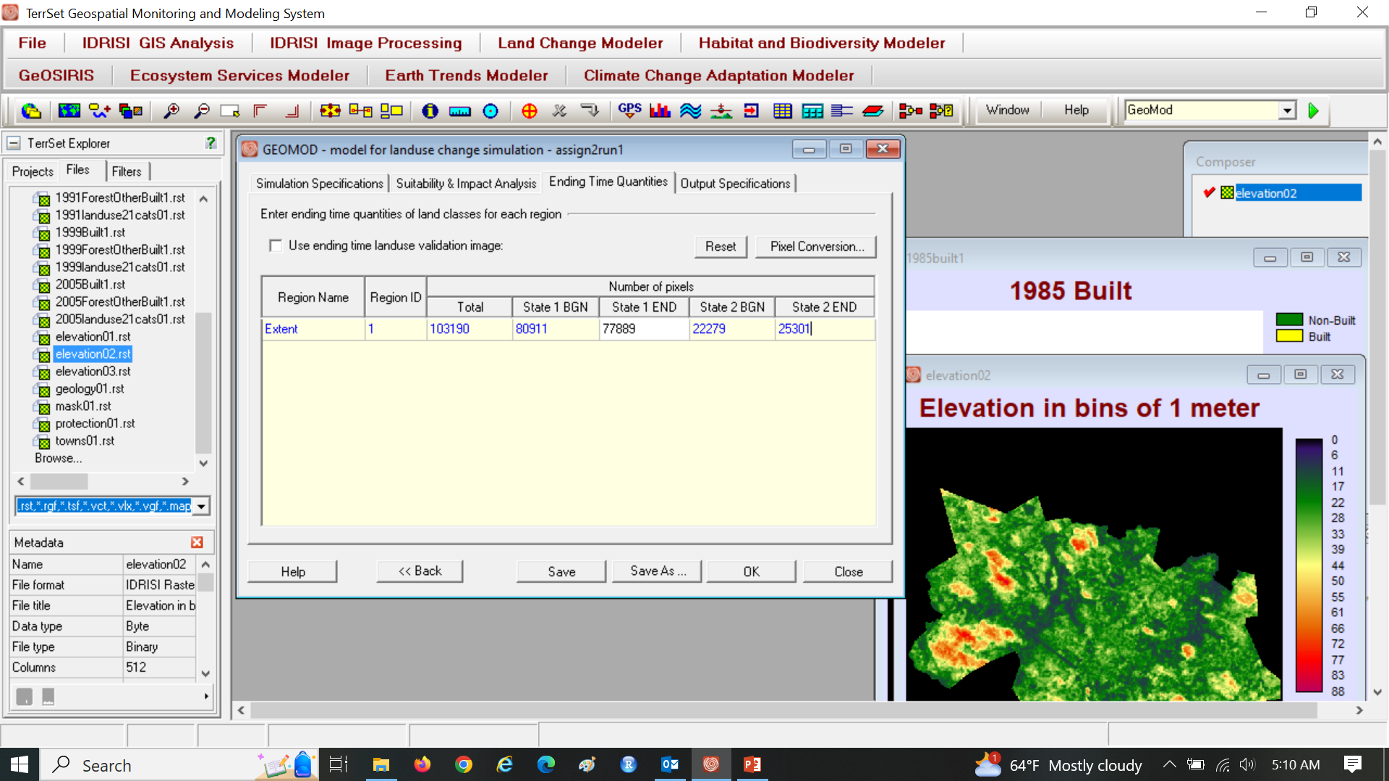
State 2 END = State 2 BGN + Gain during 1971-1985 22279-built in 1985 that will bw beinging in 1999 + the change 1971-1985 state 1 end -= non built at 1985-simulated change of 3022(this is lost to built)

Slide 20
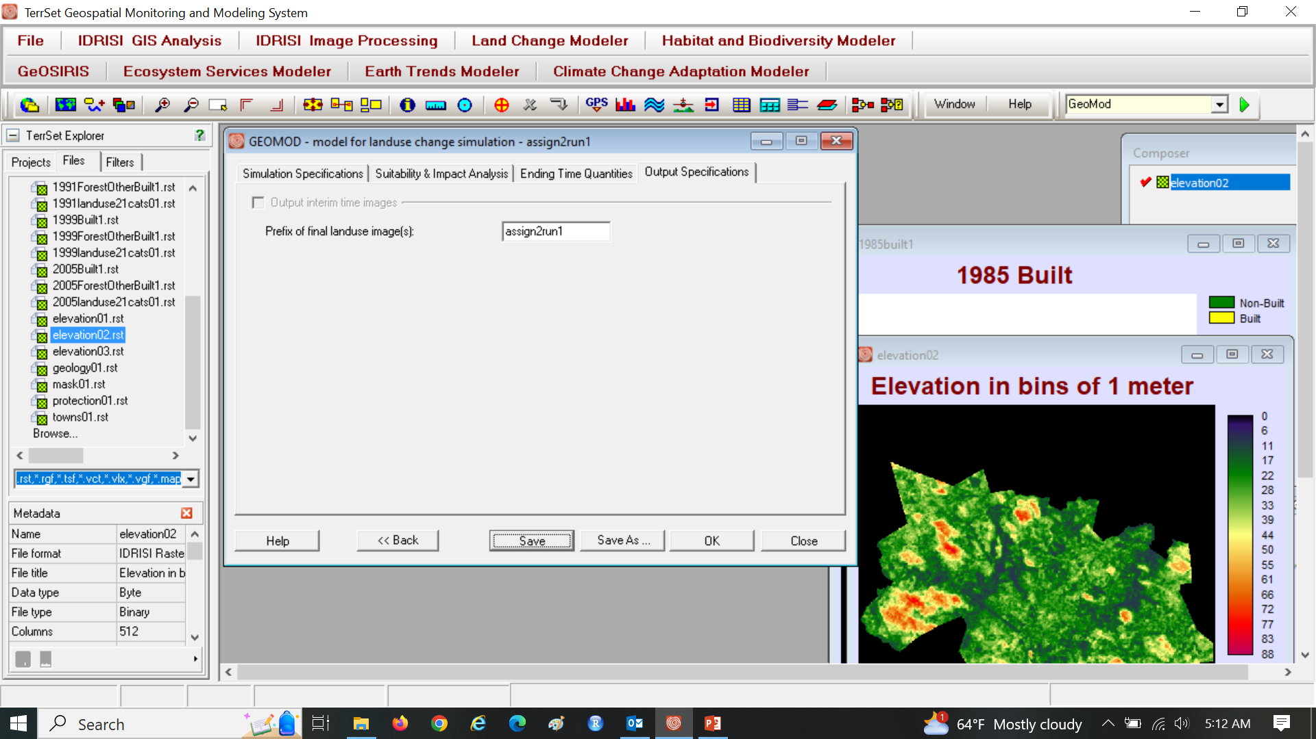
Enter prefix for filename. Click Save before OK.

Slide 21
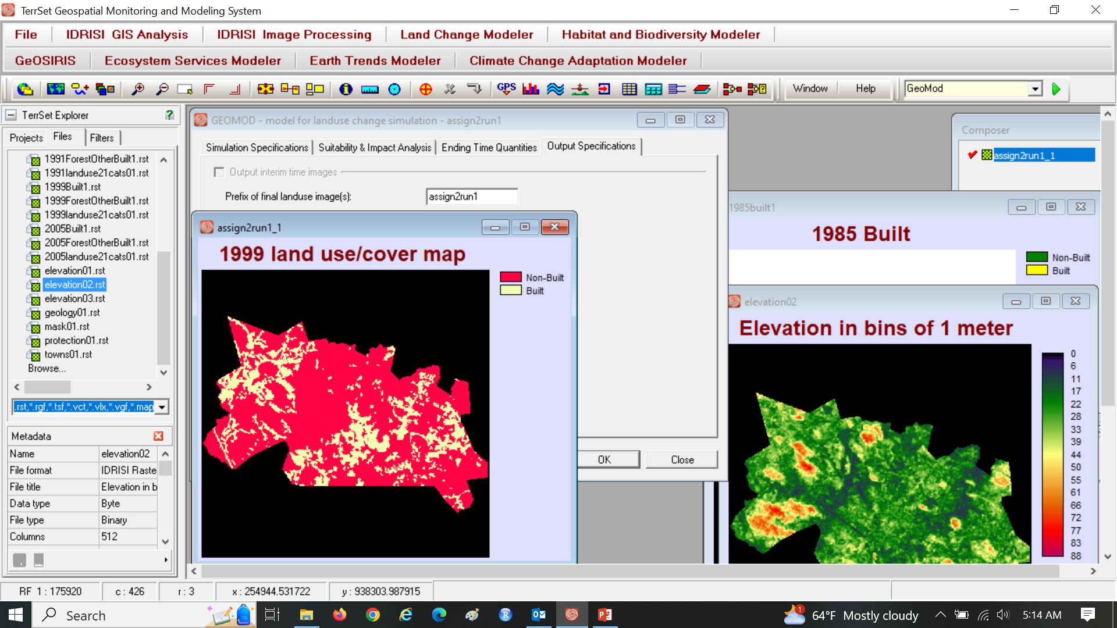
Geomod makes 1999 land map called assign2run1_1. How do we make one map to show simulated change versus persistence? By using a crosstab of the simulated and 1985 re

Slide 22
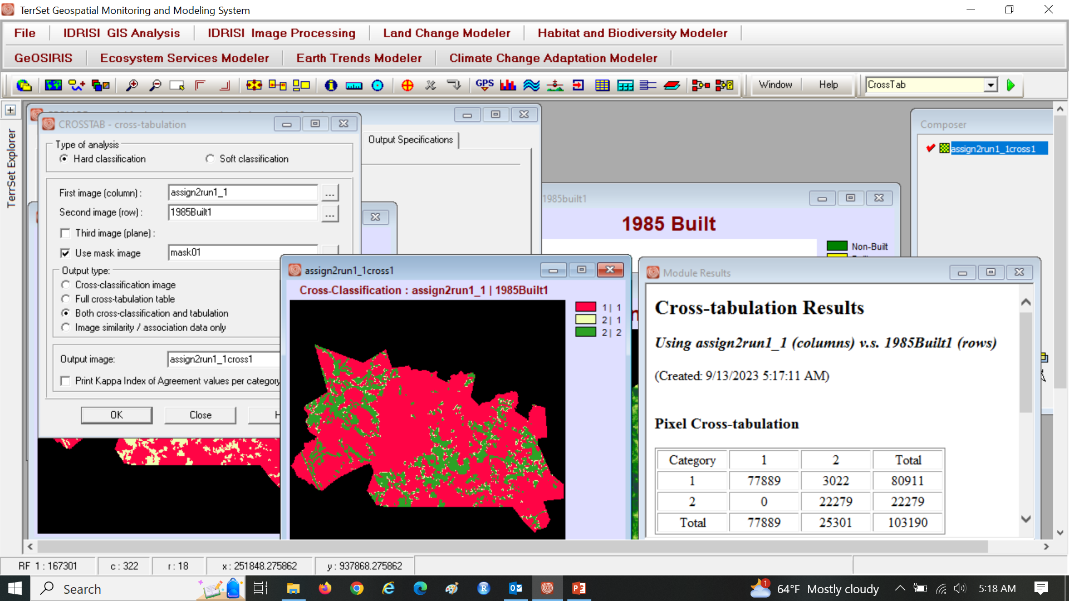
This CROSSTAB shows what? Simulated gross change of 3022, total built in 1999 is 25301

Slide 23
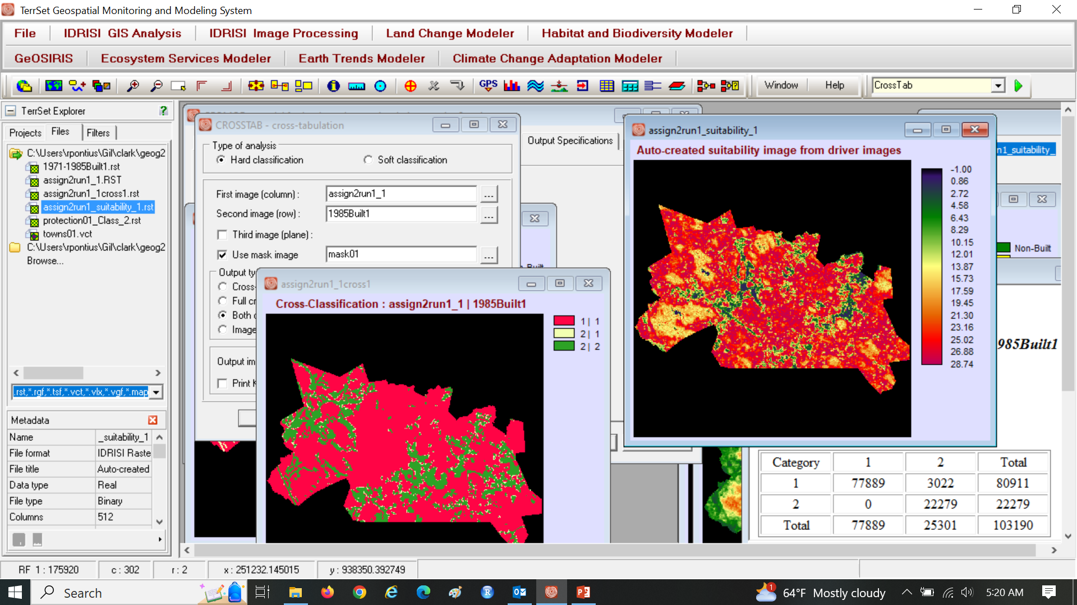
assign2run1_suitability_1 is a reclass of the driver map

Slide 24
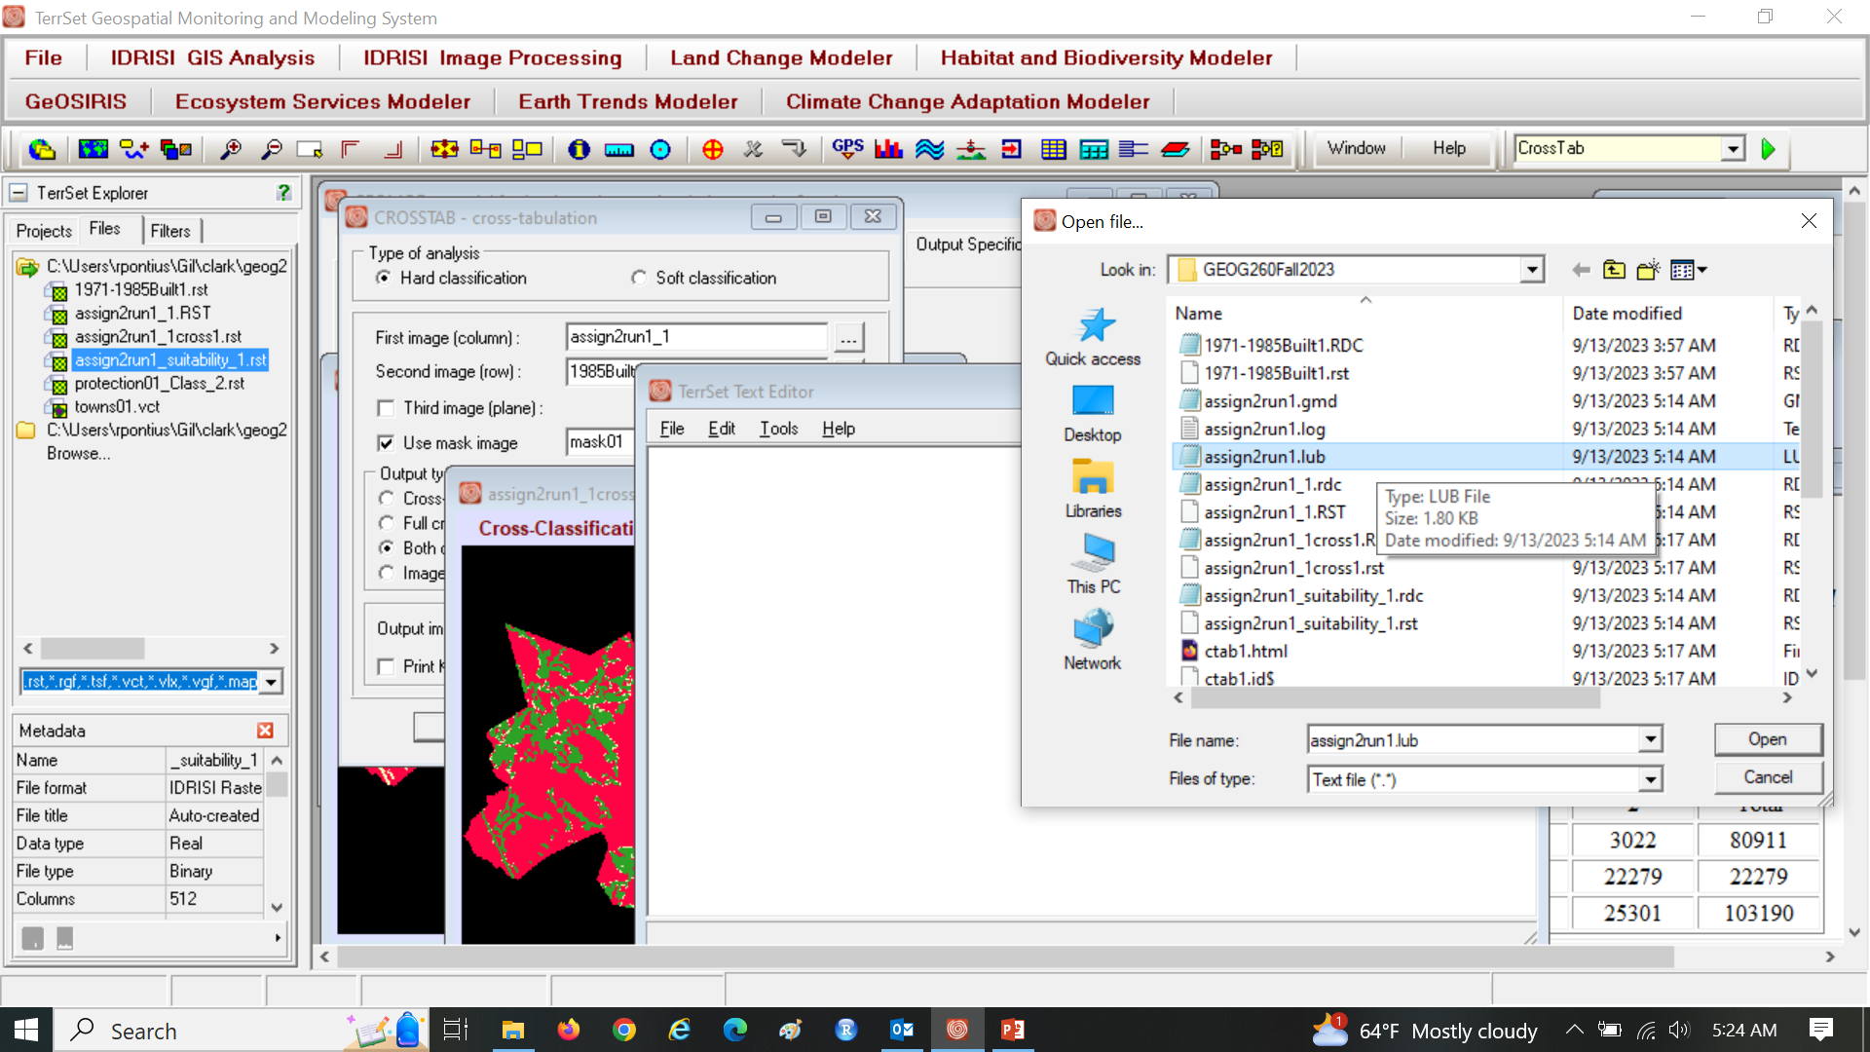
Open assign2run1_1.lub
Notes:
Open teeeset text editor on the status bar that has the symbol red arrow in a blue square.

Slide 25
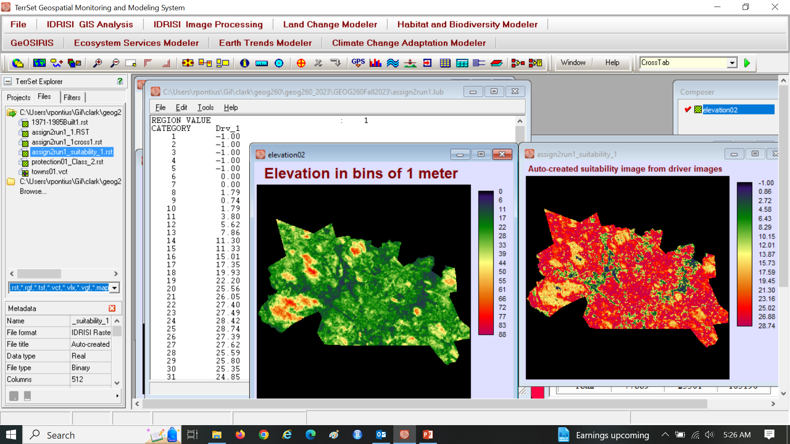
assign2run1_1.lub shows a ratio for each elevation bin
Notes:
% ratio=No. of built pixels at a each elevation/ Total no. of pixels in the in the elevation BIN(I)
The elevation bins are the 1 meter elevtions under the category in the assign1run1_lub text file.

Slide 26
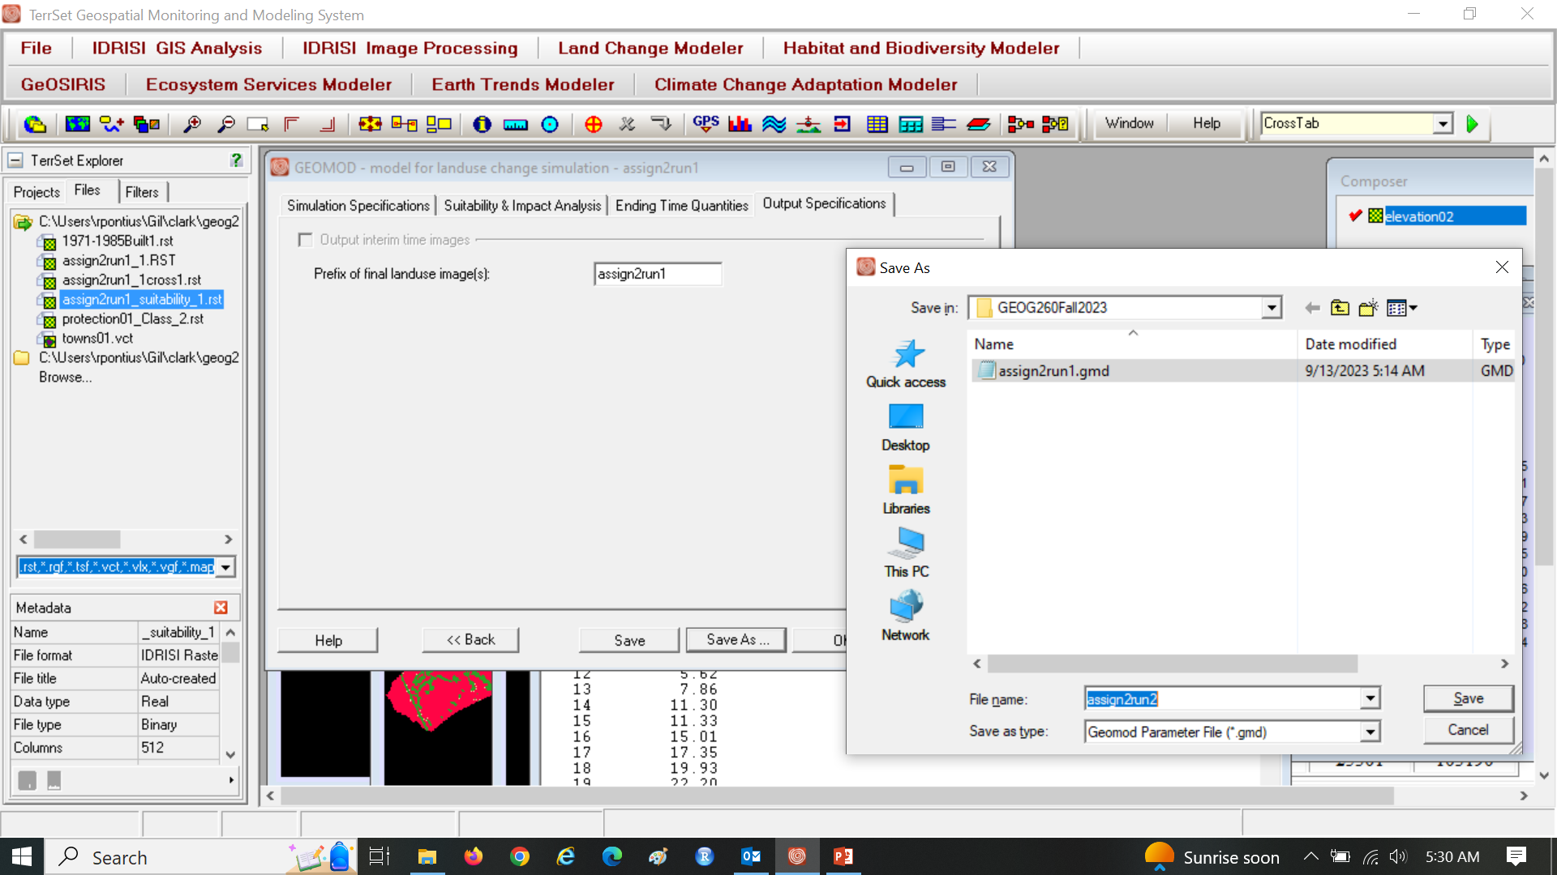
Click Save As from GEOMOD to save a new file assign2run2.gmd file to store the parameters for run2.

Slide 27
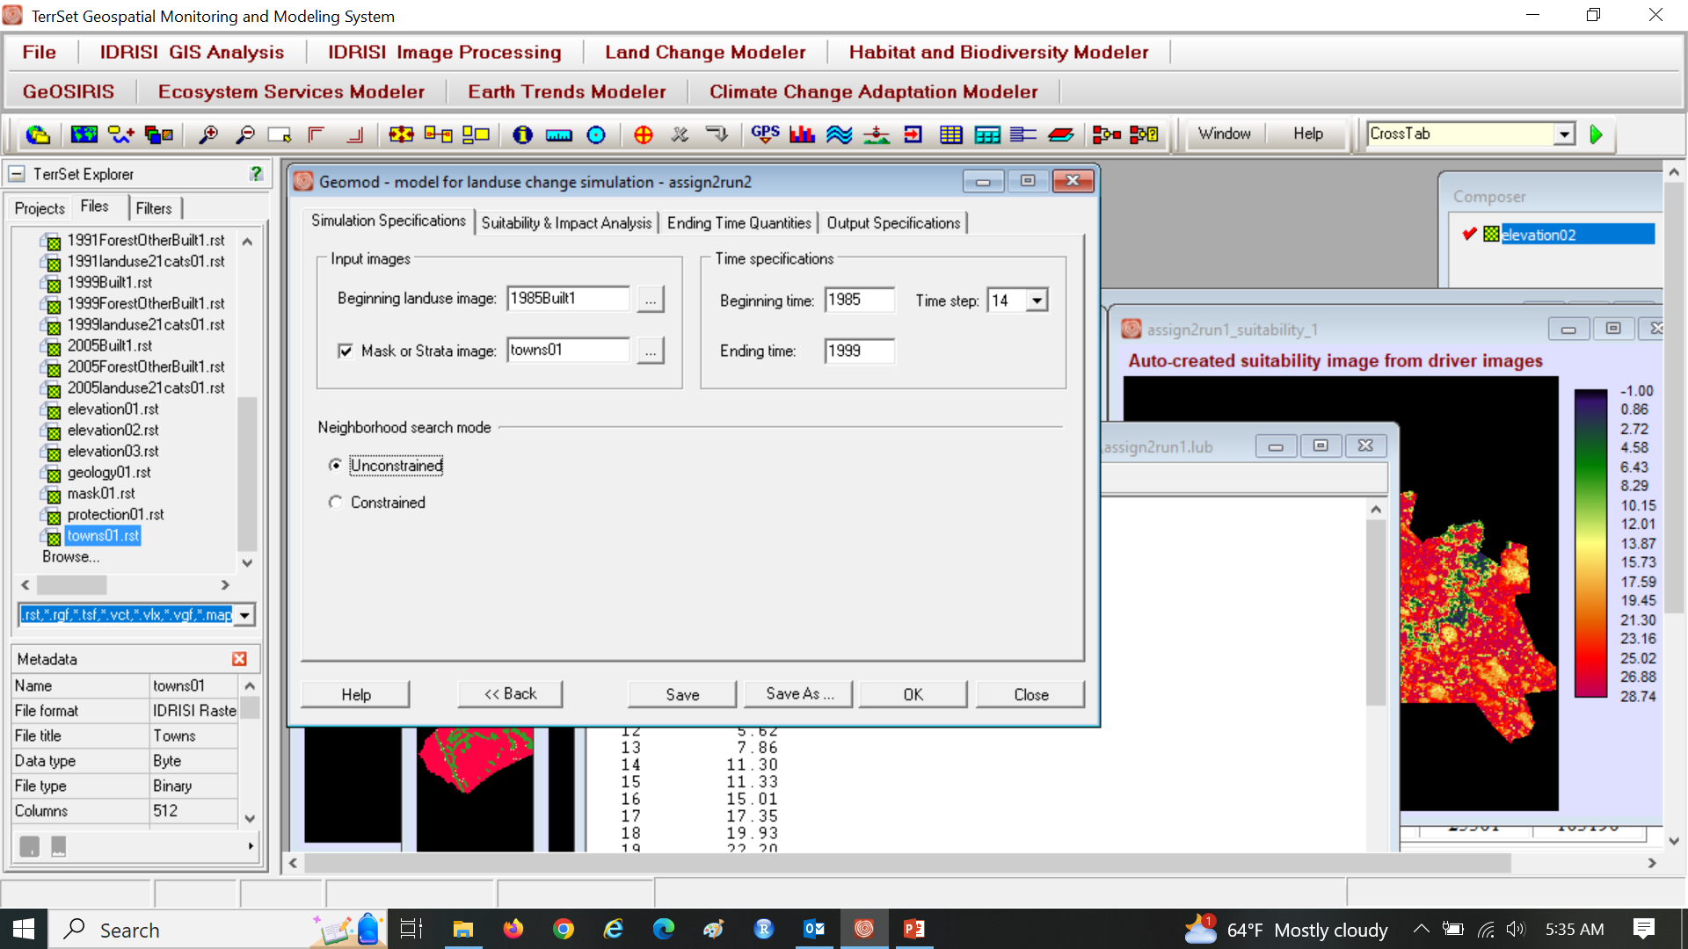
Edit Run 2 with towns as strata and unconstrained.

Slide 28
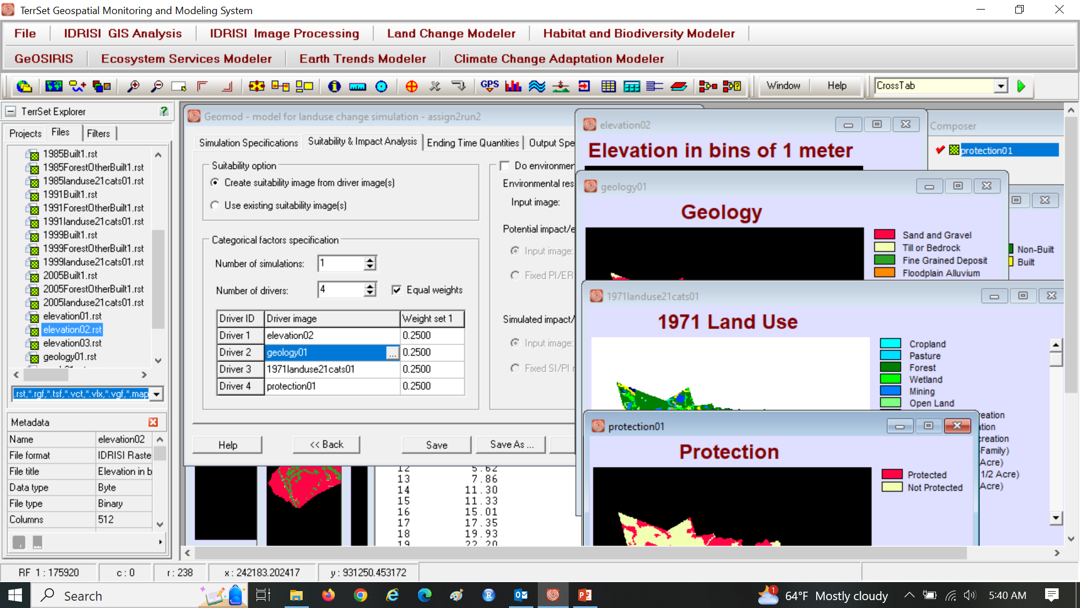
Run 2 uses four driver maps

Slide 29
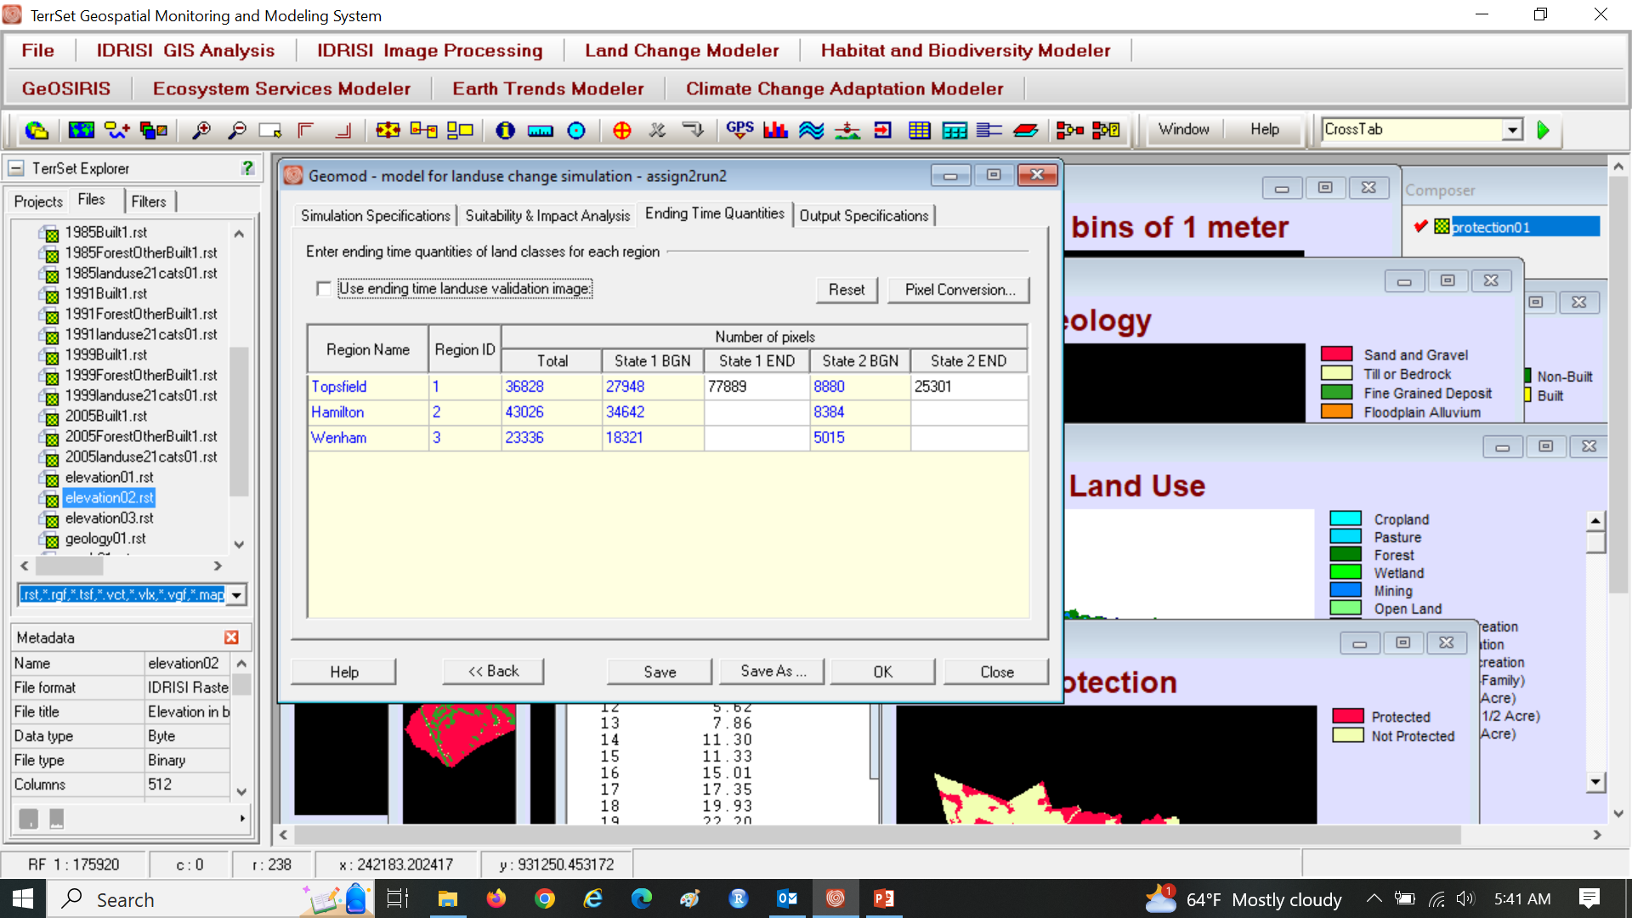
Click Reset

Slide 30

You must specify the State 2 END for each town

Slide 31
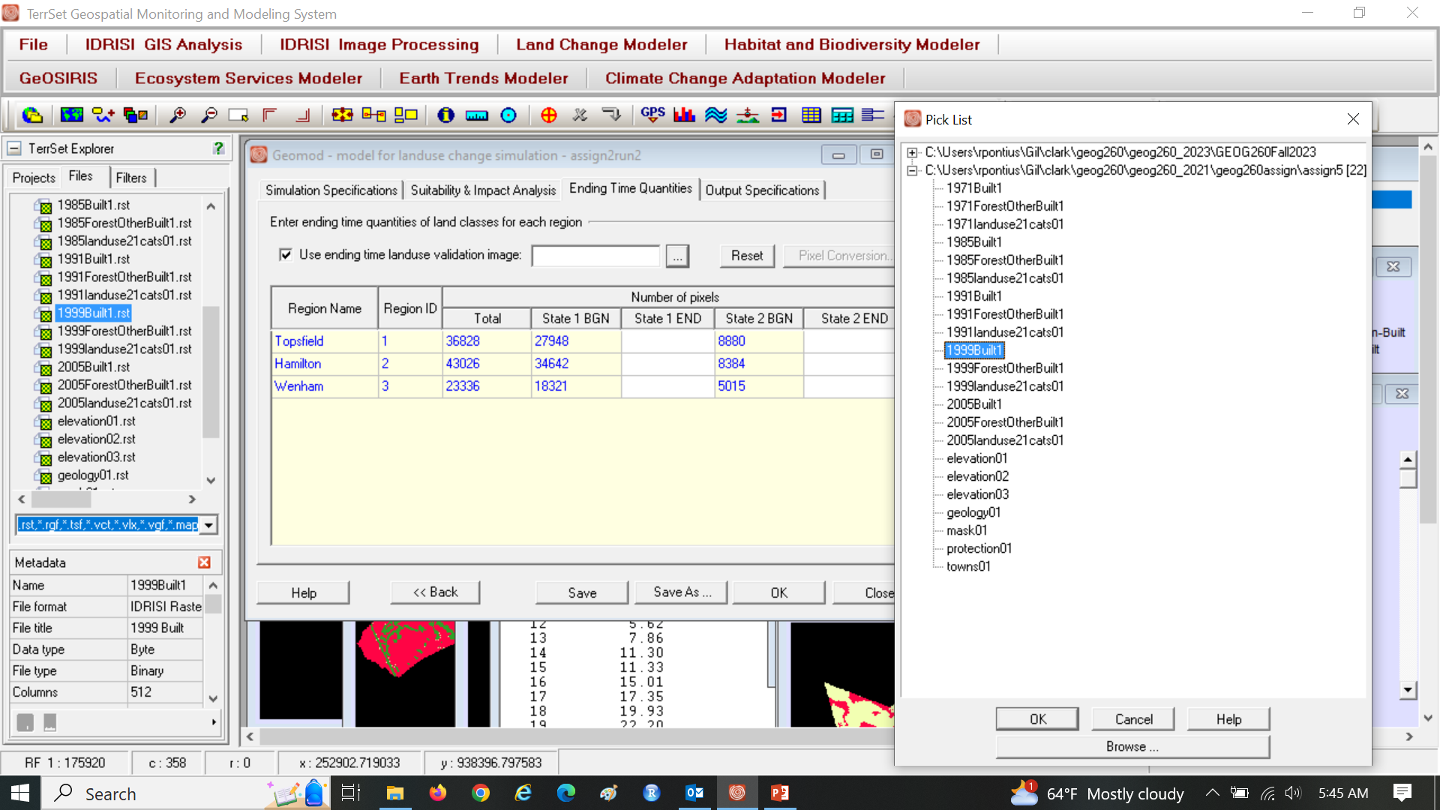
Use ending time the select 1999Built1 via the list

Slide 32
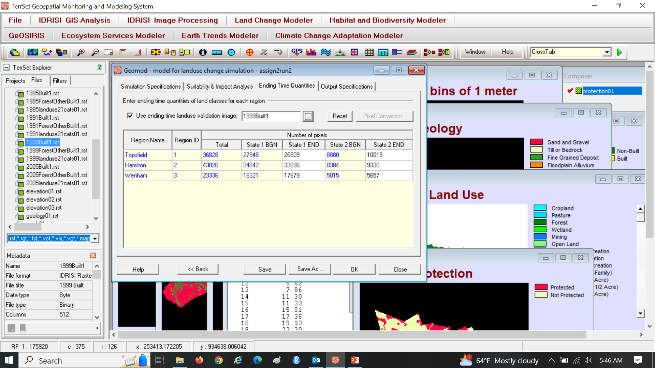
This fills the correct 1999 quantity for each town

Slide 33
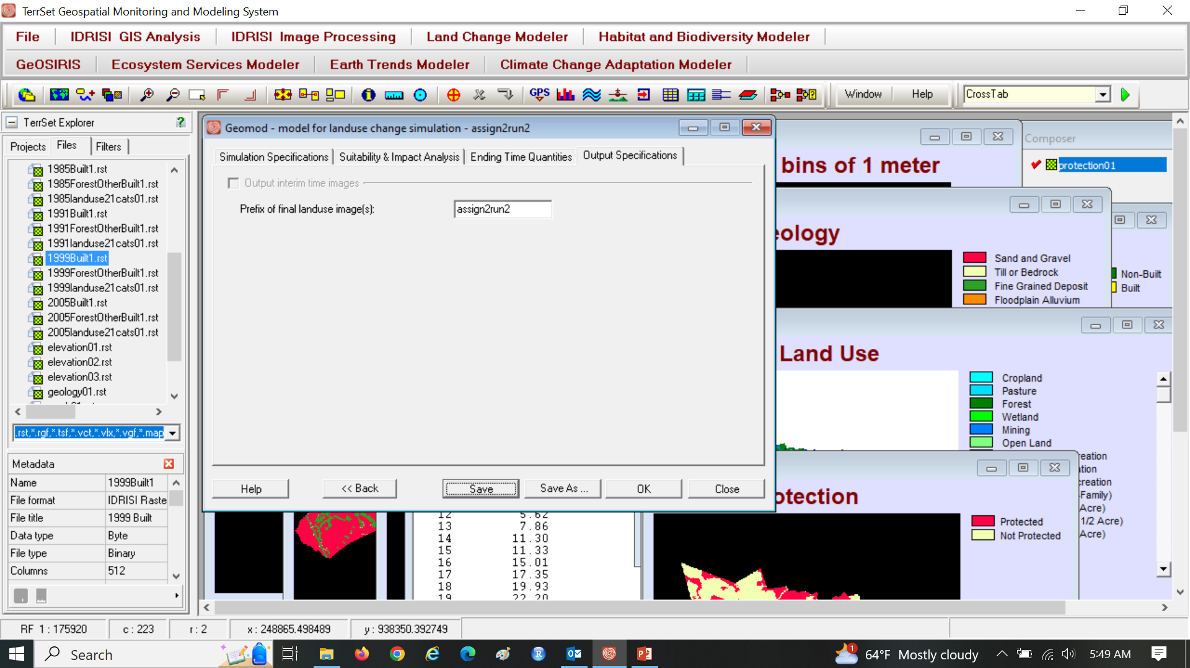
Specify assign2run2, Click Save before OK

Slide 34
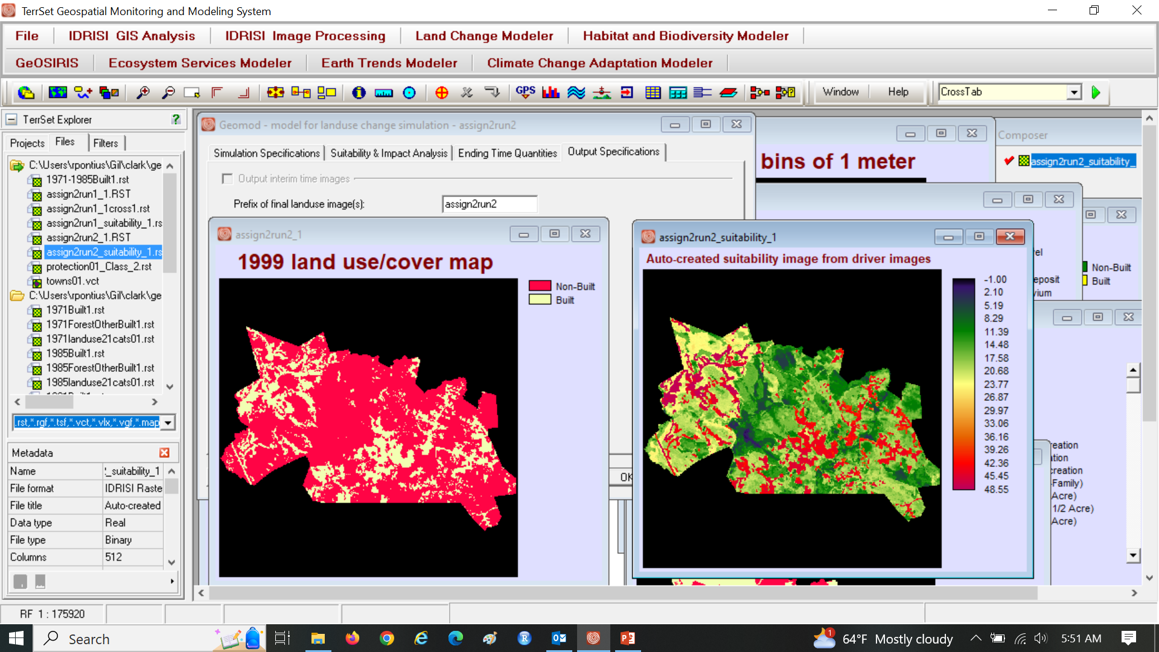
See the 1999 extrapolation and suitability map

Slide 35
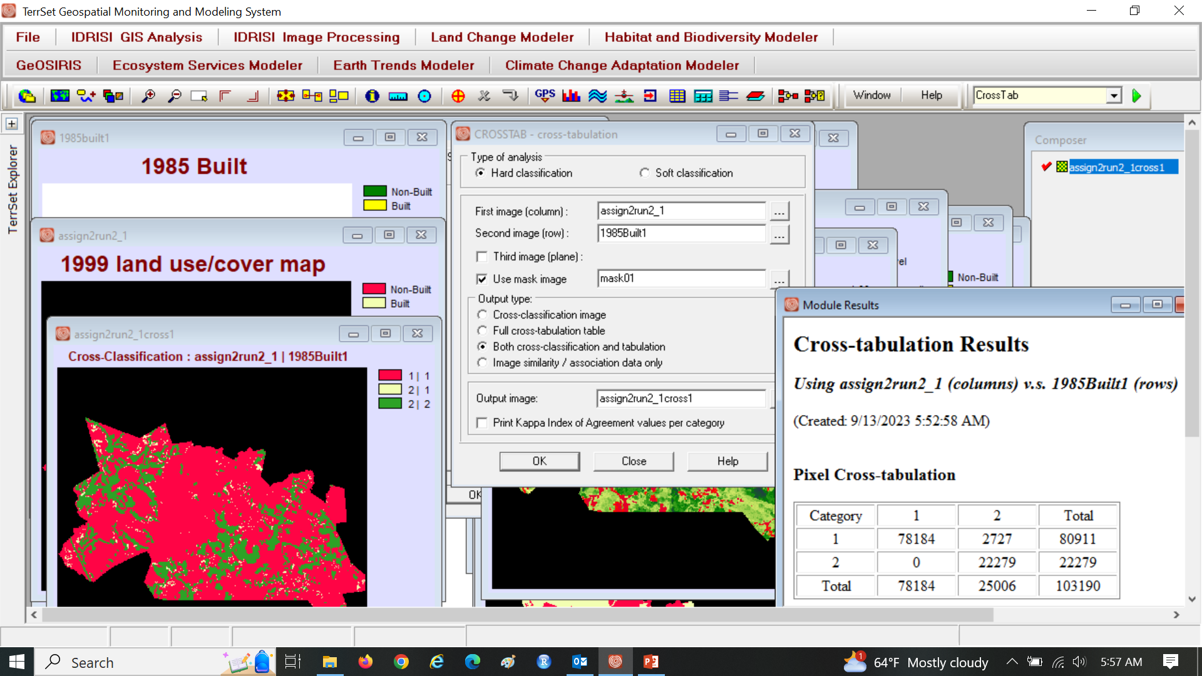
CROSSTAB shows simulated change of assign1run2

Slide 36
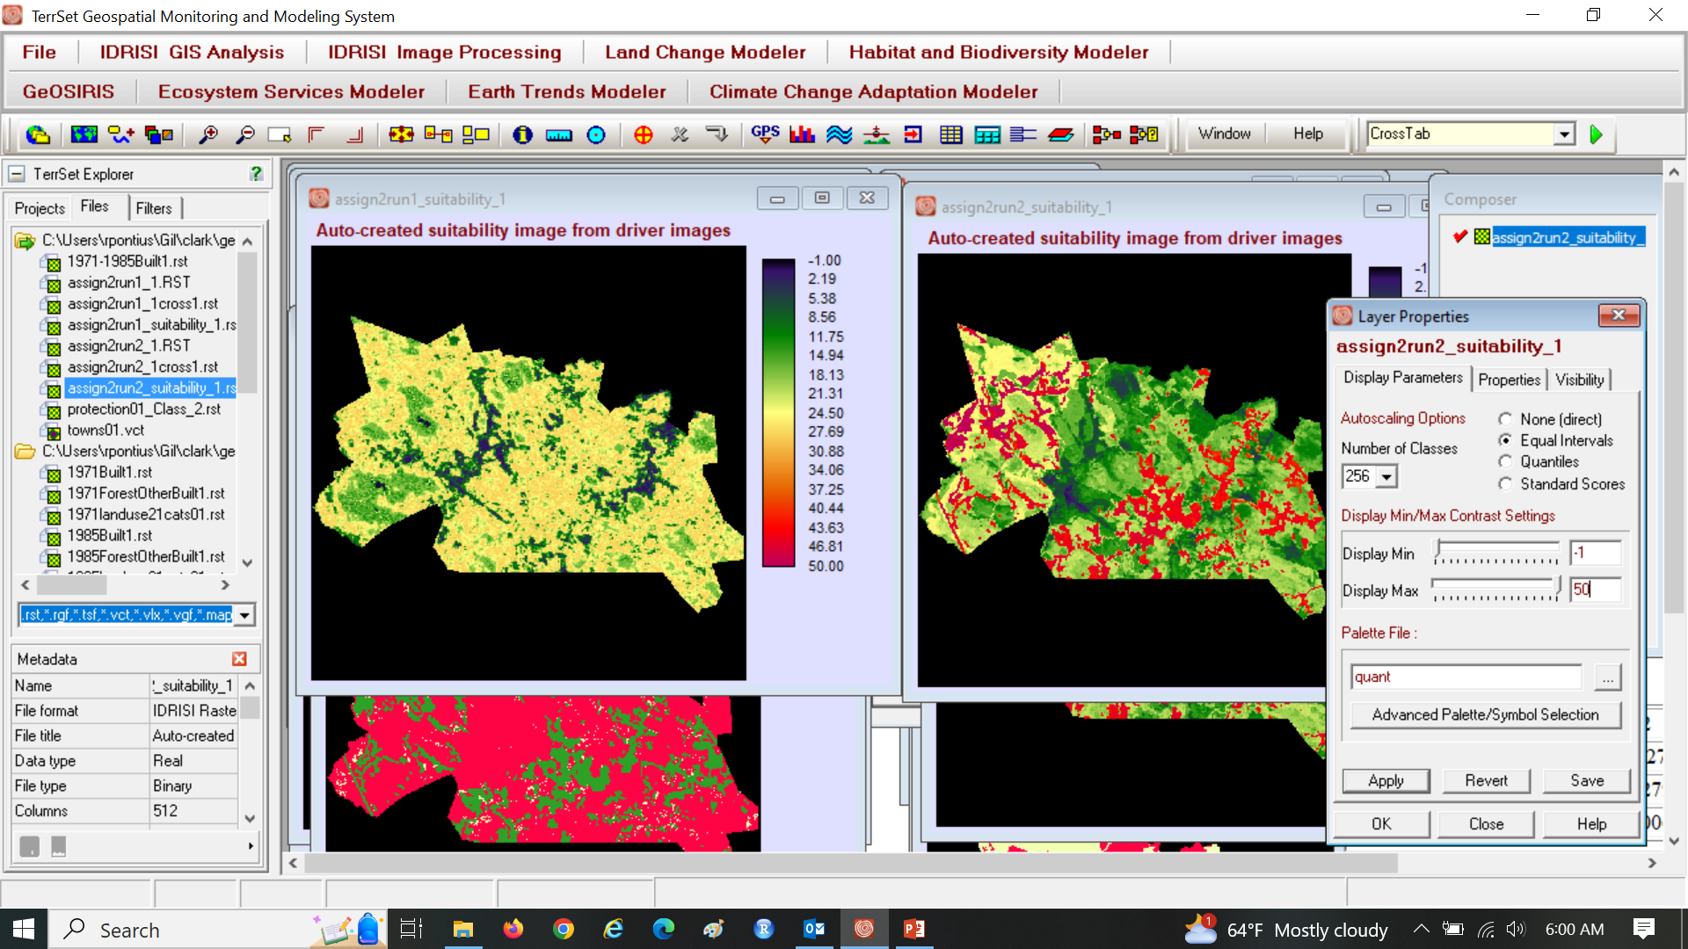
Set Display Max to 50 for both suitability maps

Slide 37
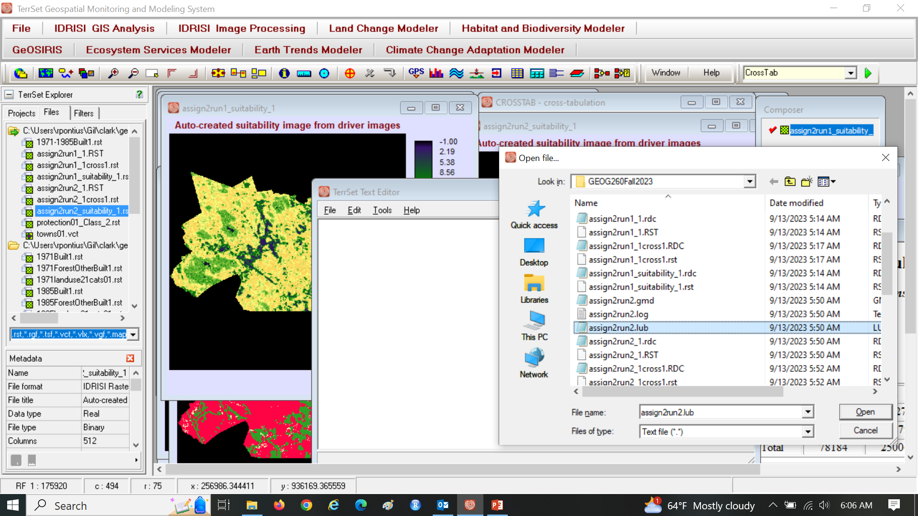
Use Notepad to see assign2run2.lub

Slide 38
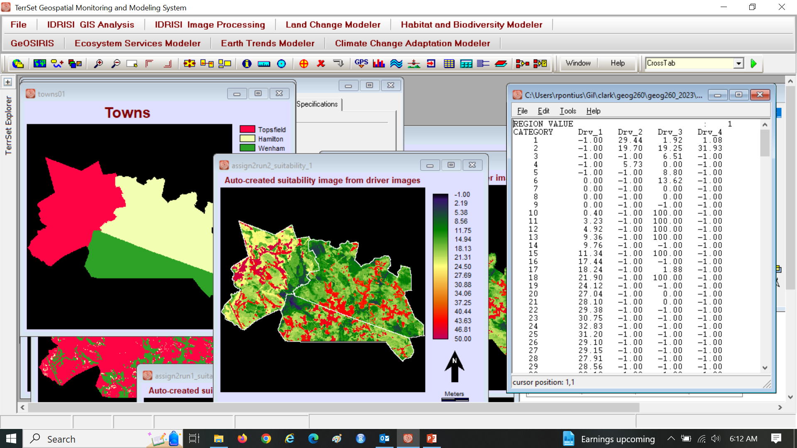
See values of each bin of each driver of each town

Slide 39
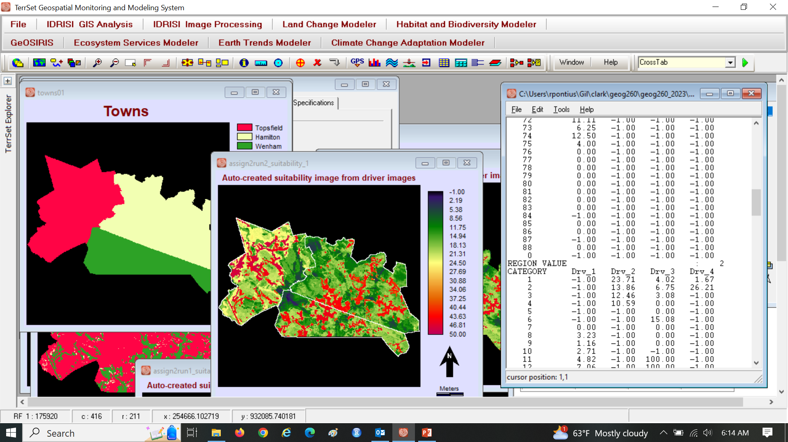
See values of each bin of each driver of each town

Slide 40
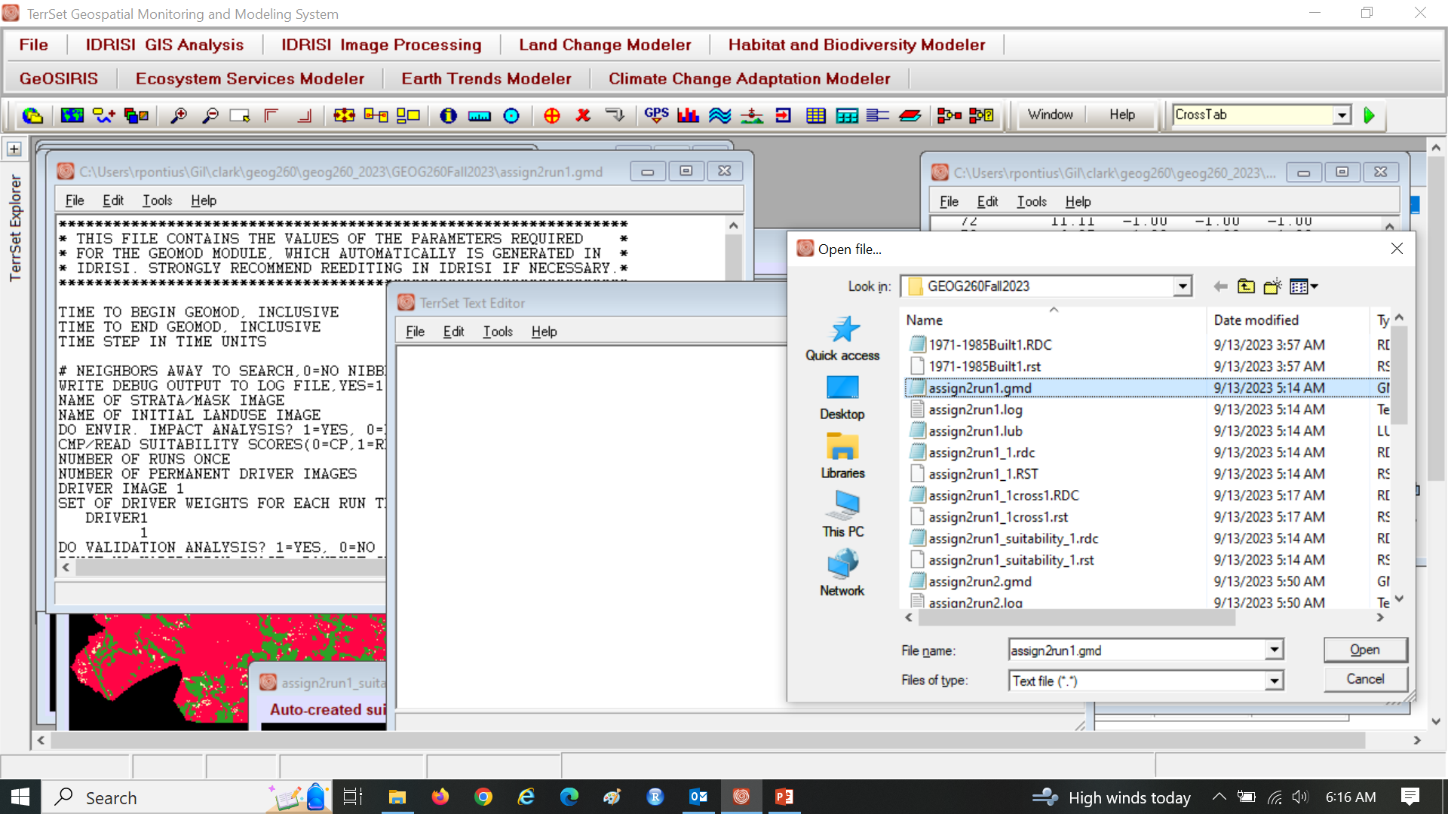
Use Notepad to see *.GMD, which is a text file

Slide 41
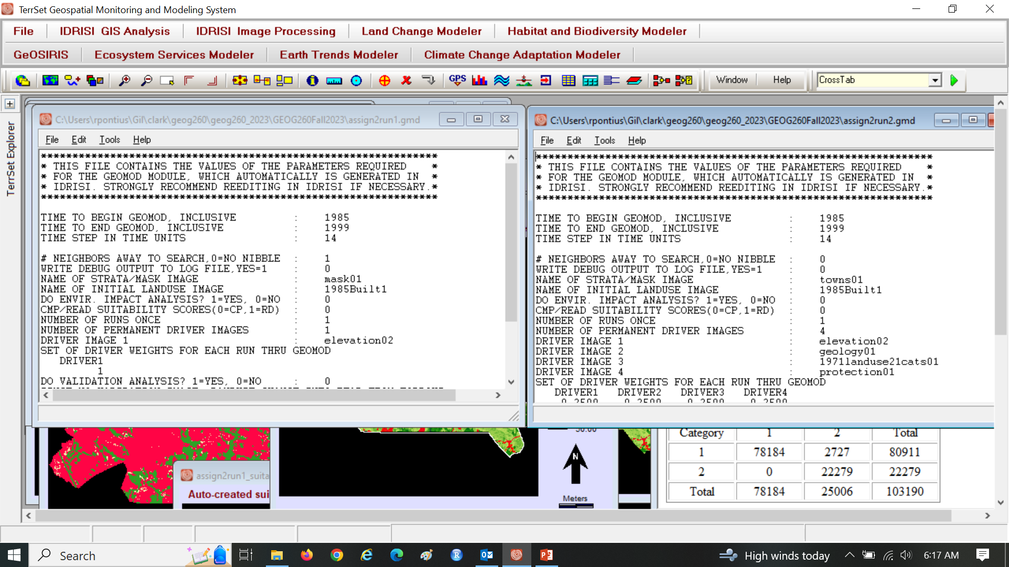
Compare assign2run1.gmd to assign2run2.gmd

Slide 42
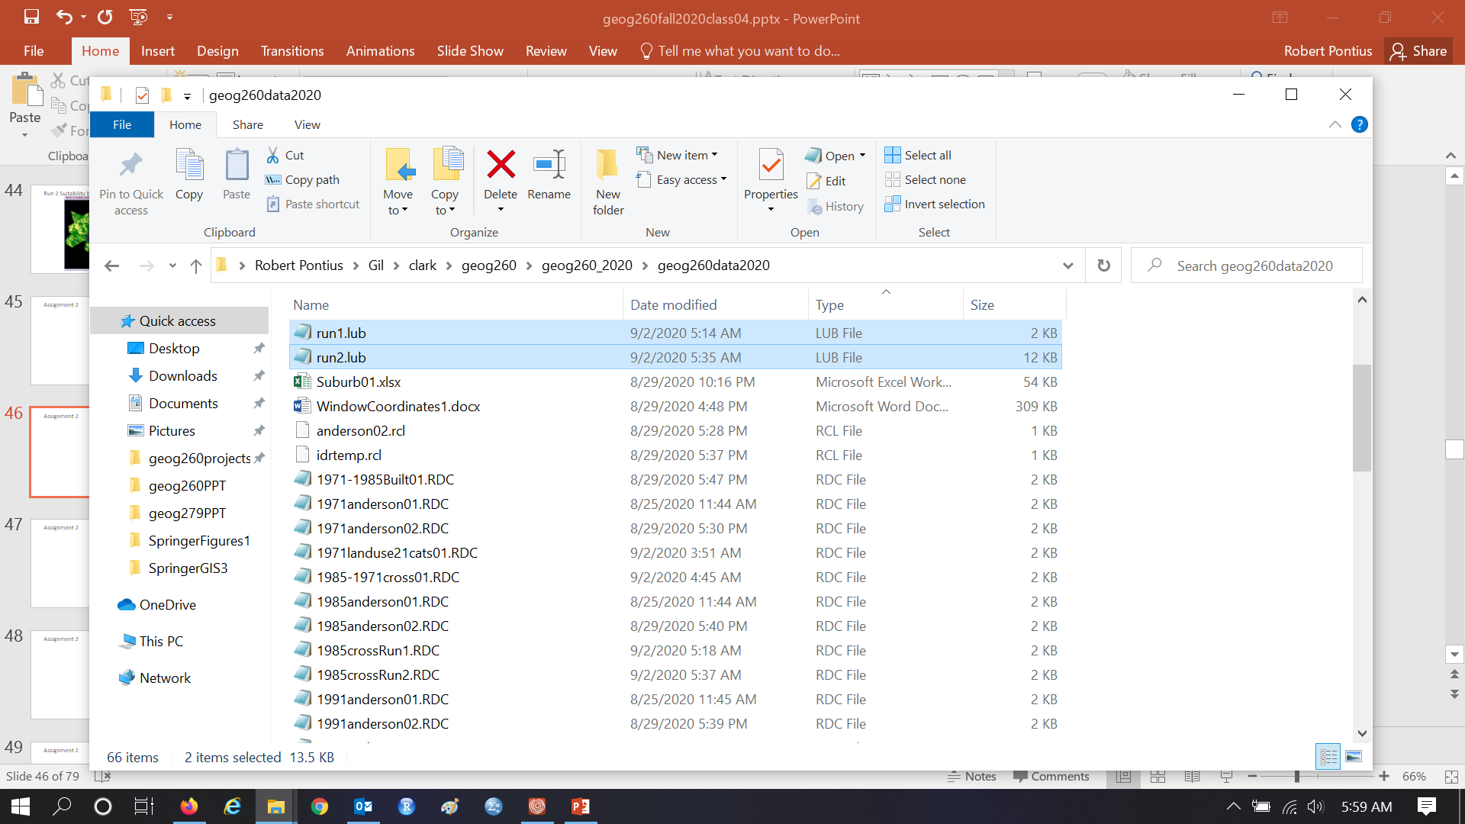
Assignment 2

Slide 43
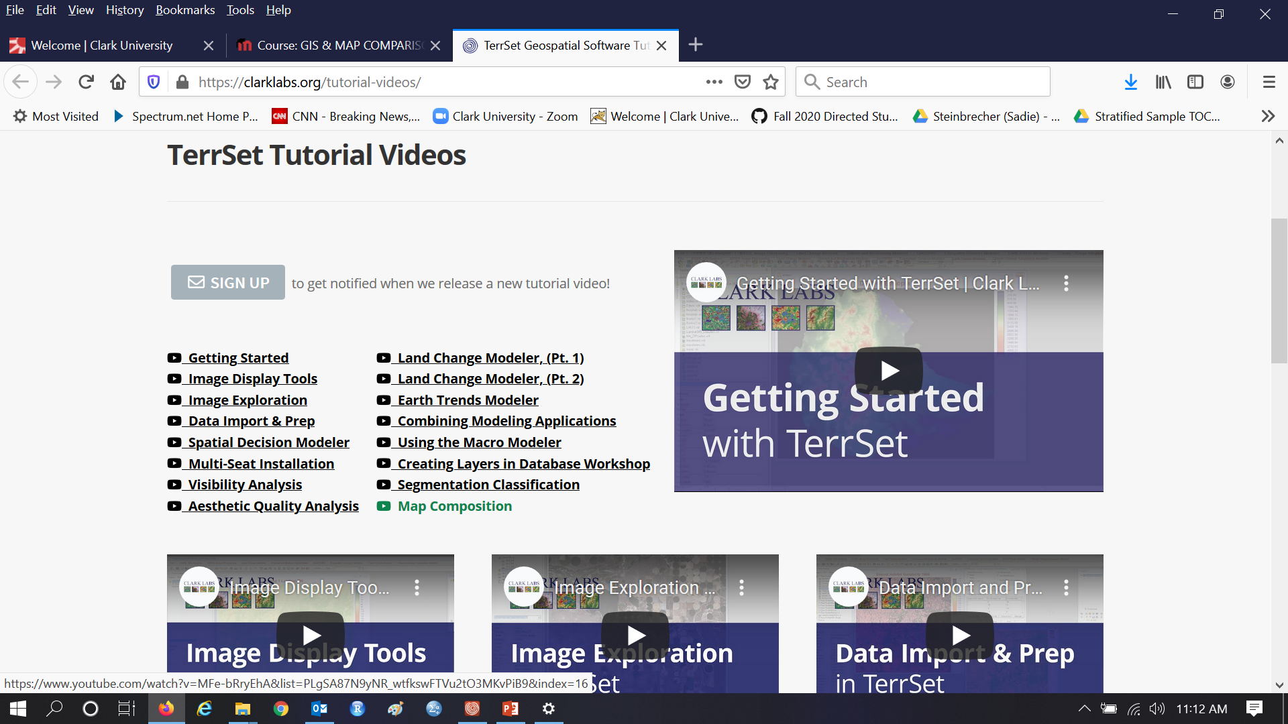
Watch Video concerning Map Composition

Slide 44
Example of how to modify an image

Slide 45
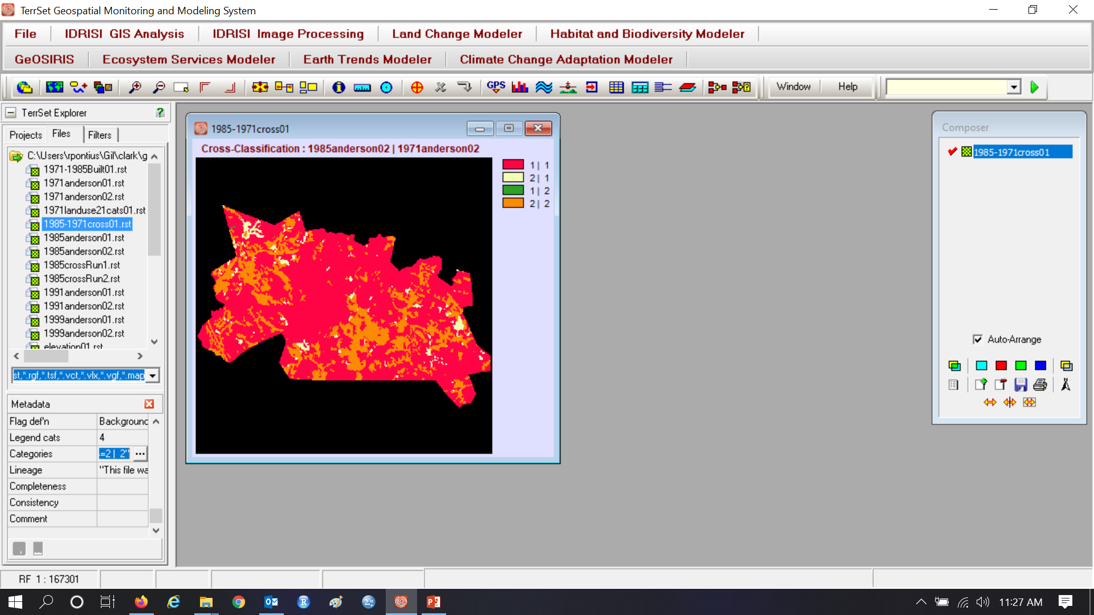
Legend, Pallete, Scale Bar, & North Arrow

Slide 46
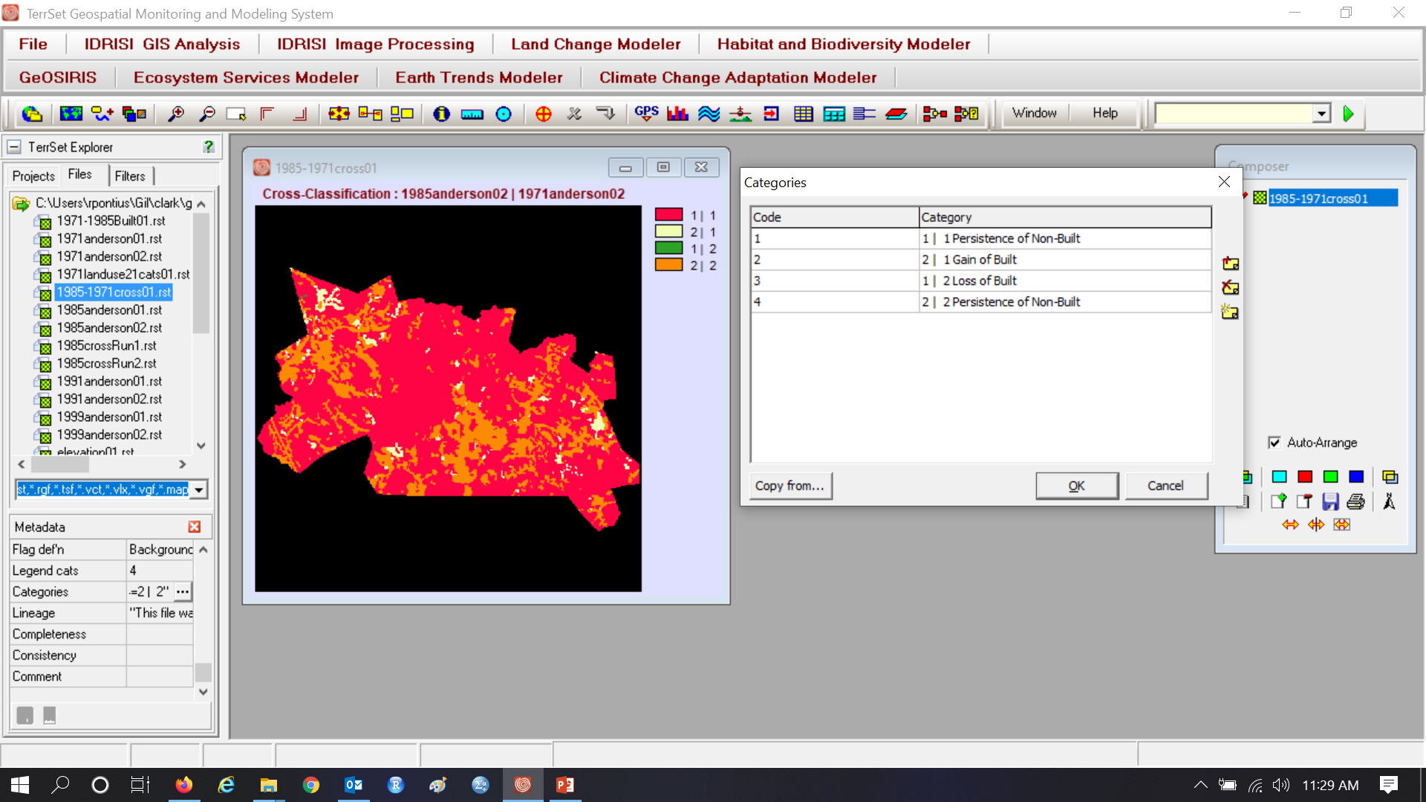
Legend, Pallete, Scale Bar, & North Arrow

Slide 47

Remember to click the save button

Slide 48
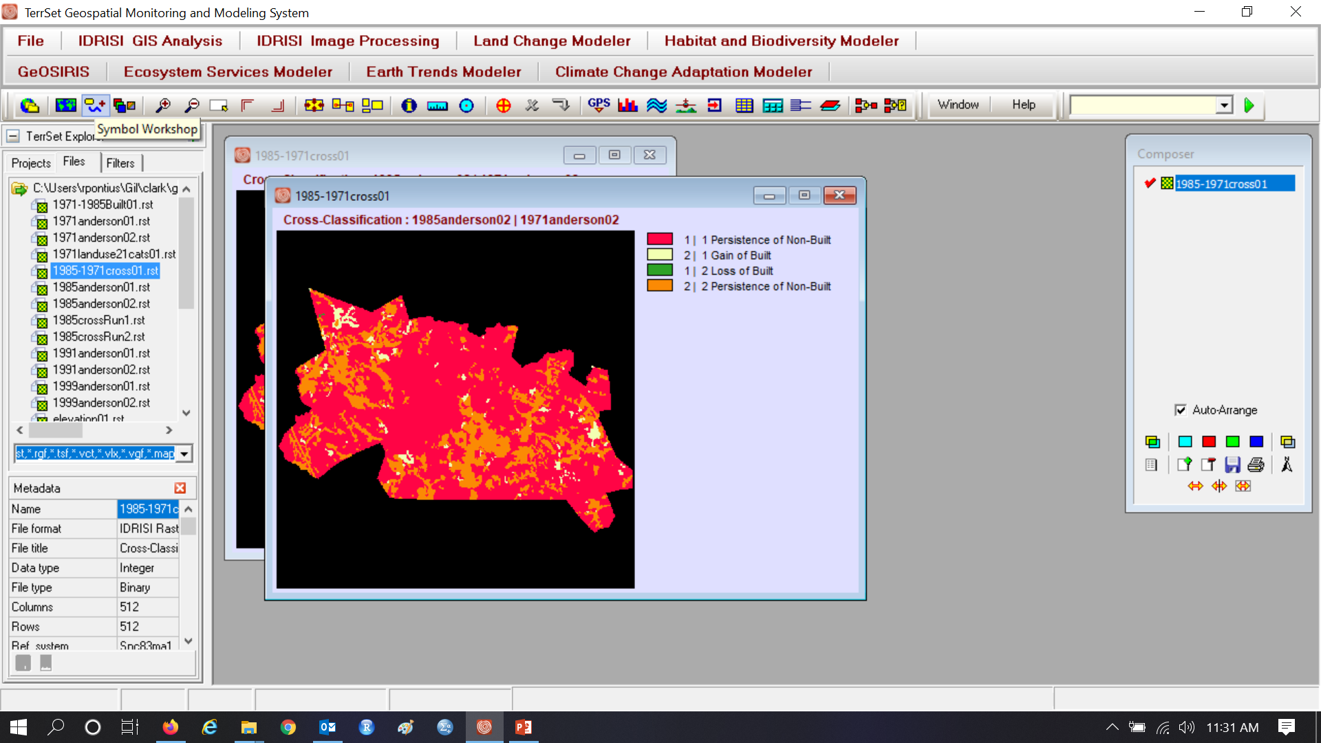
Legend, Pallete, Scale Bar, & North Arrow

Slide 49
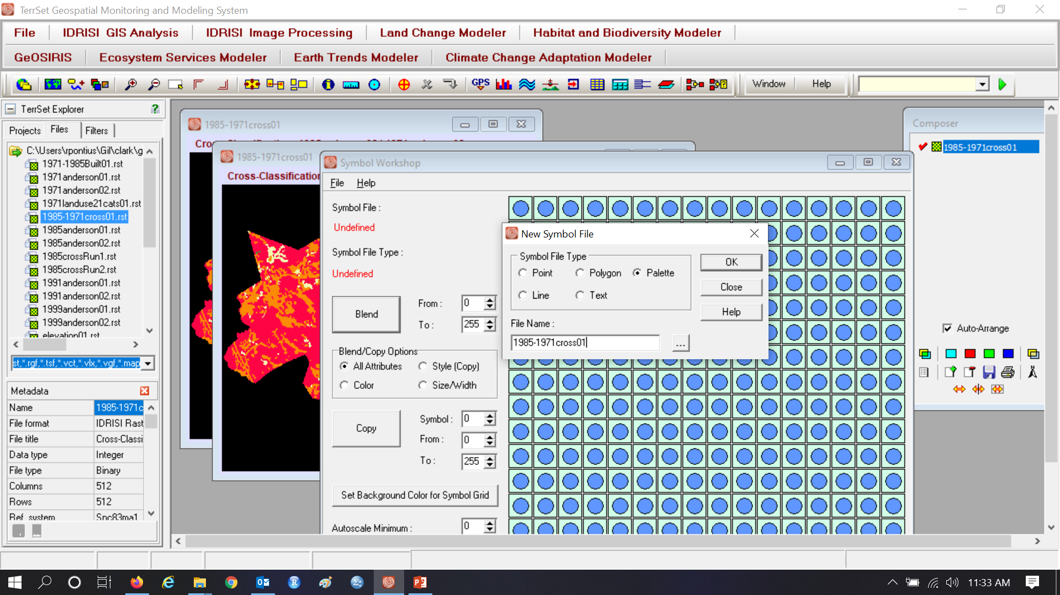
Legend, Pallete, Scale Bar, & North Arrow

Slide 50
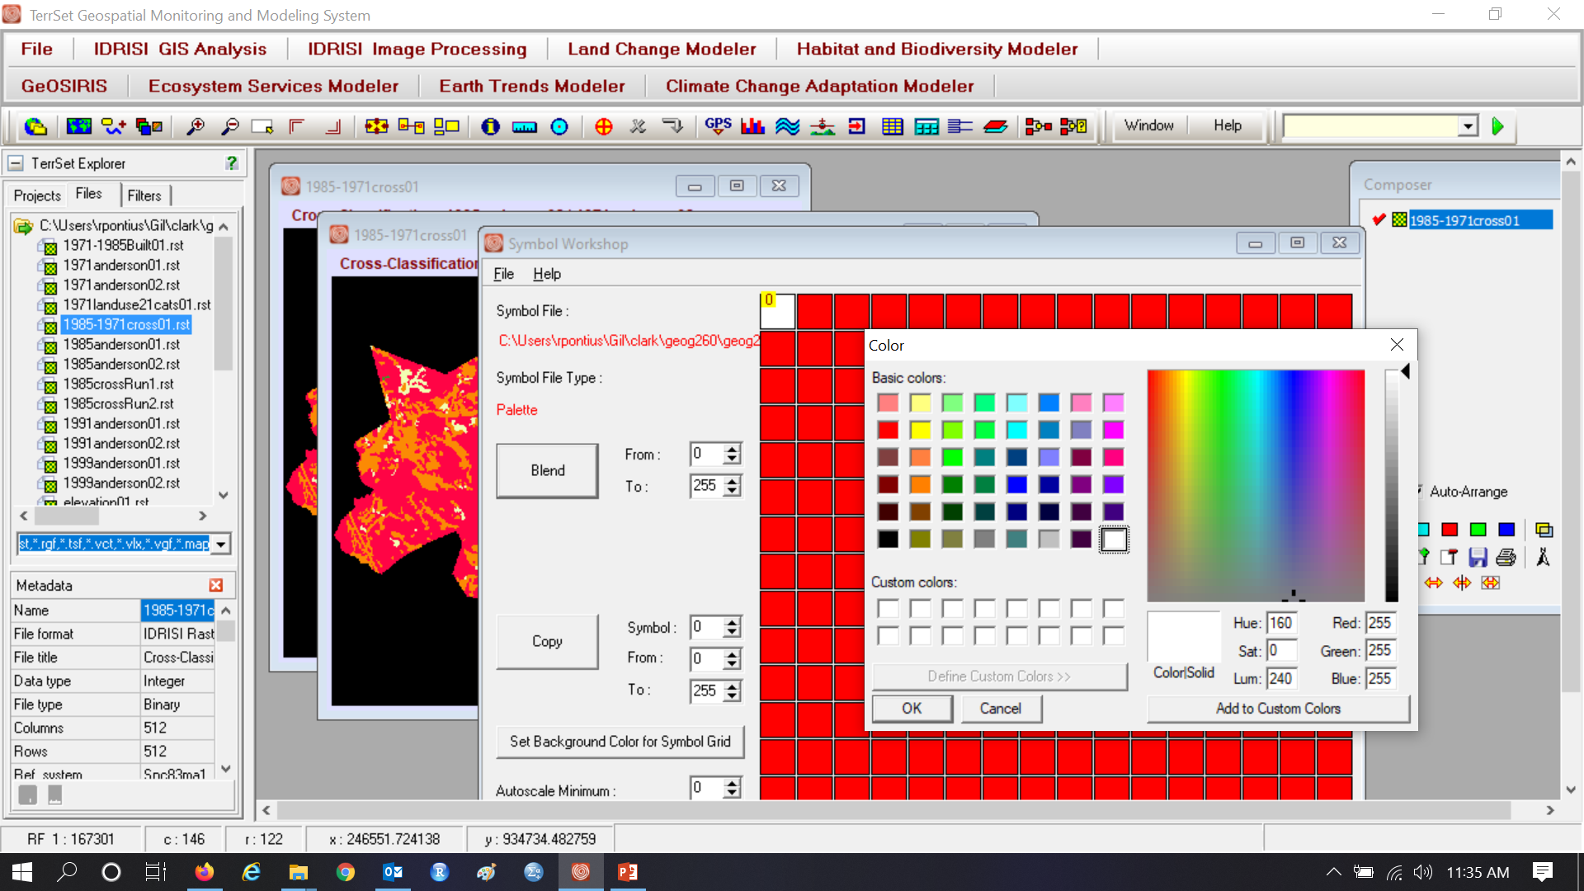
Legend, Pallete, Scale Bar, & North Arrow

Slide 51
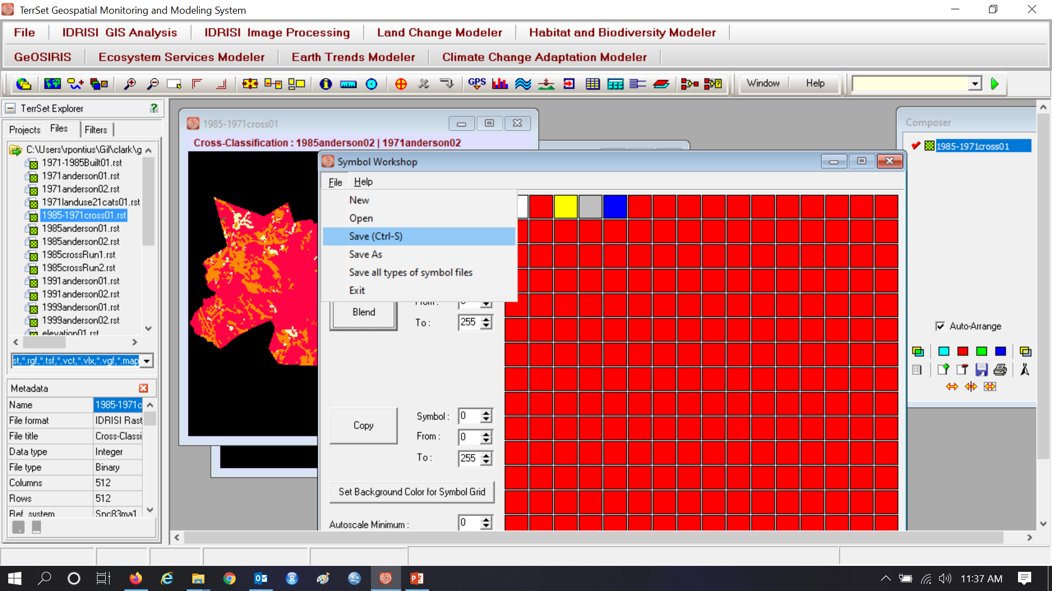
Legend, Pallete, Scale Bar, & North Arrow

Slide 52
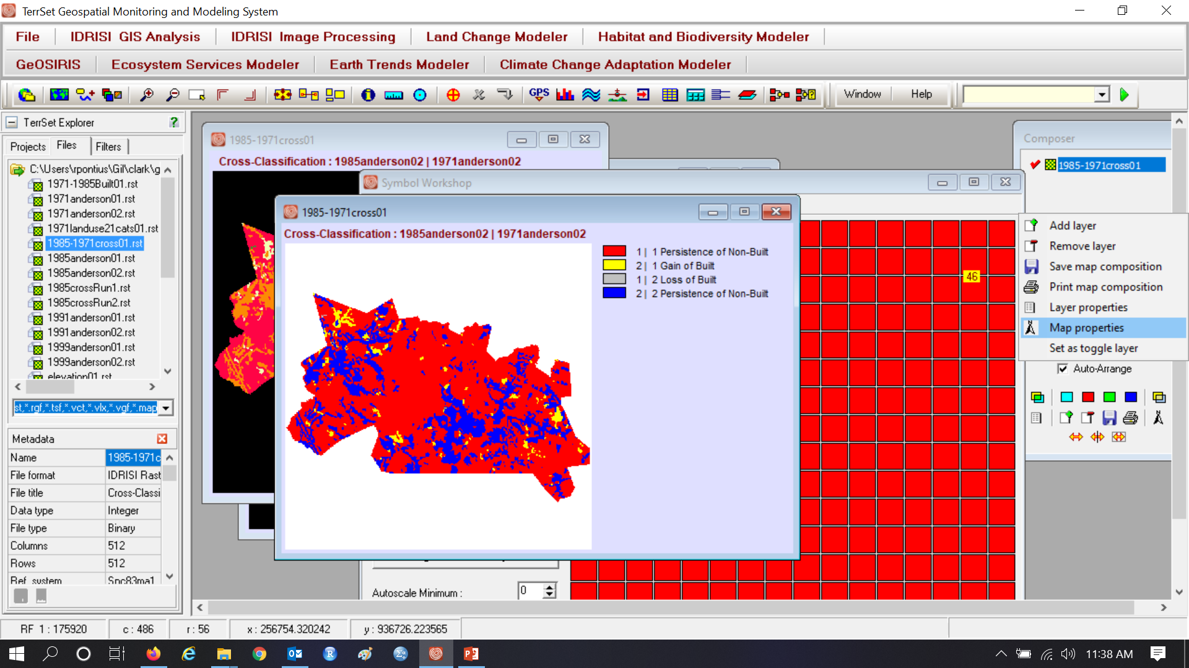
Legend, Pallete, Scale Bar, & North Arrow

Slide 53
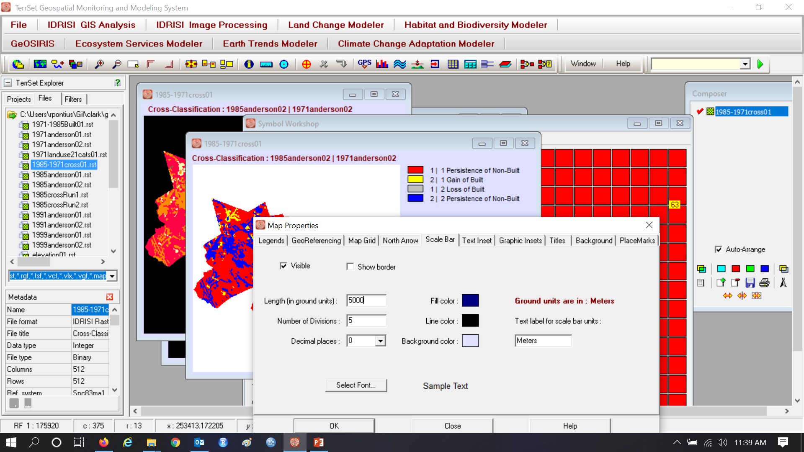
Legend, Pallete, Scale Bar, & North Arrow

Slide 54
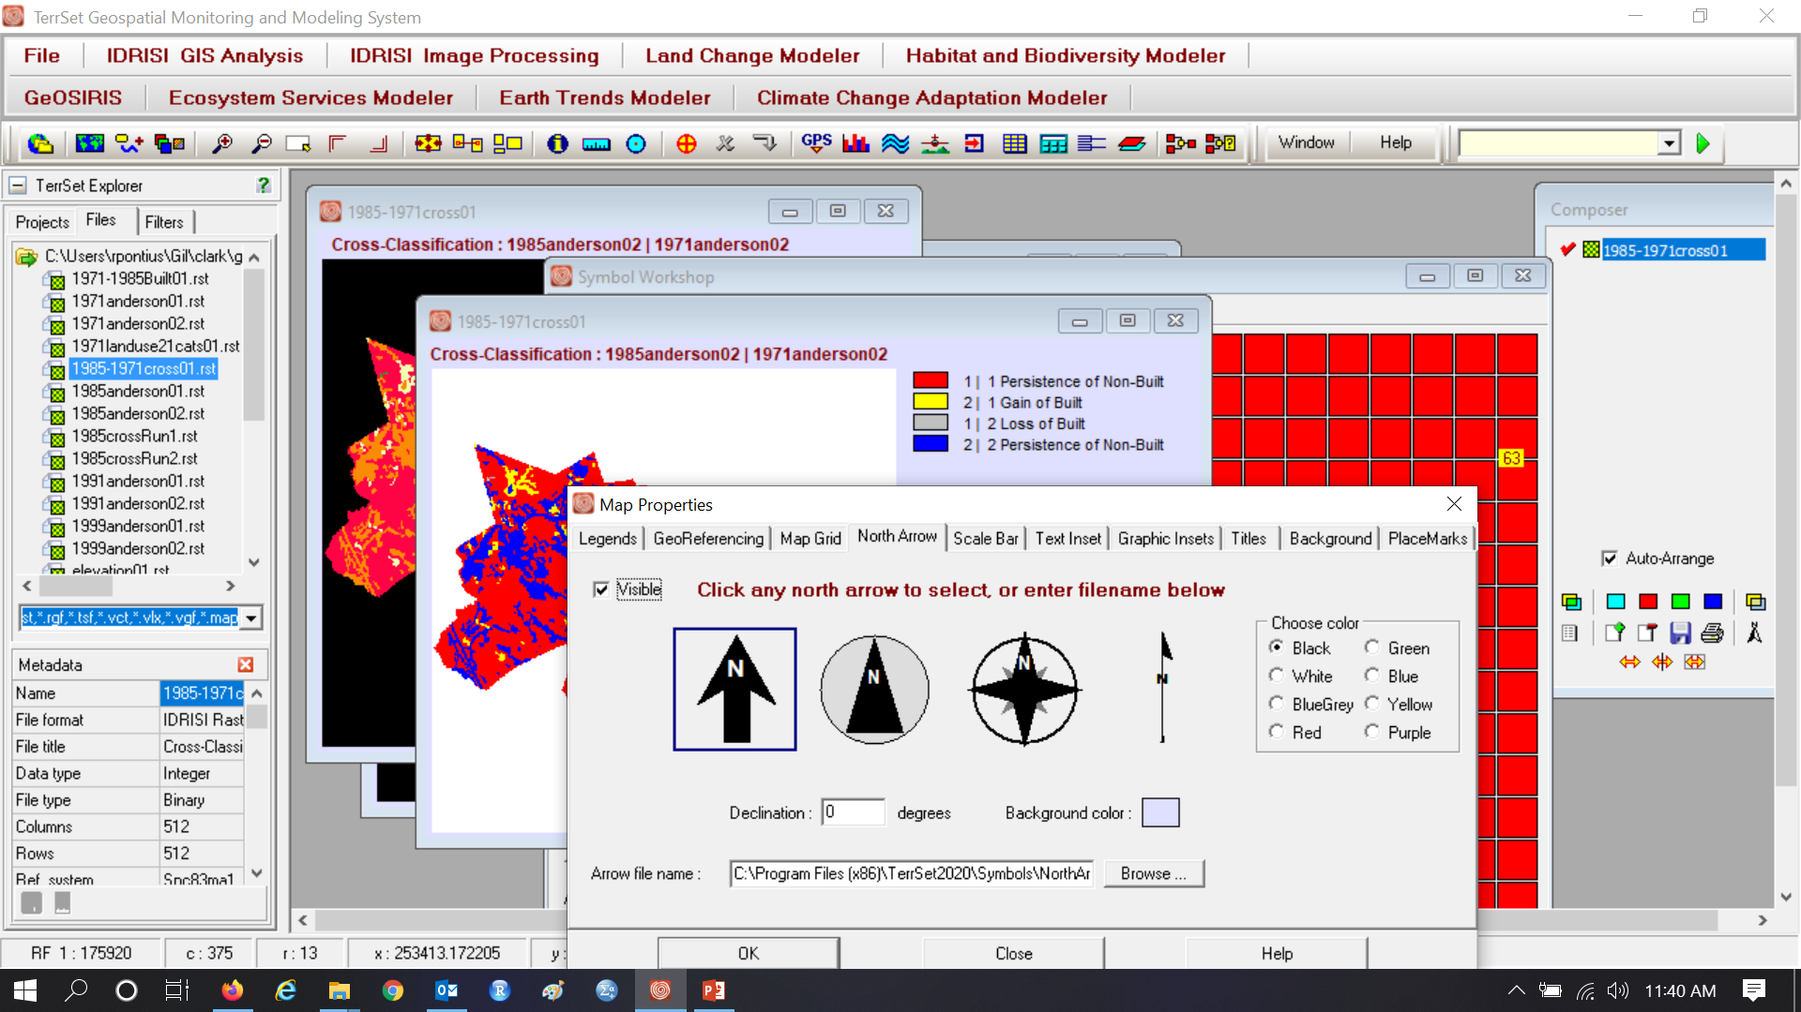
Legend, Pallete, Scale Bar, & North Arrow

Slide 55
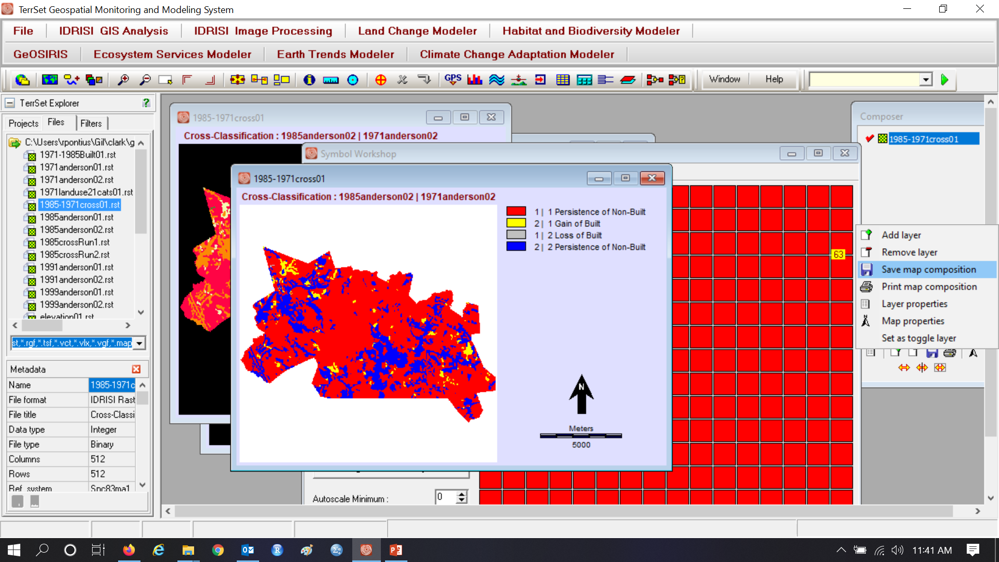
Legend, Pallete, Scale Bar, & North Arrow

Slide 56
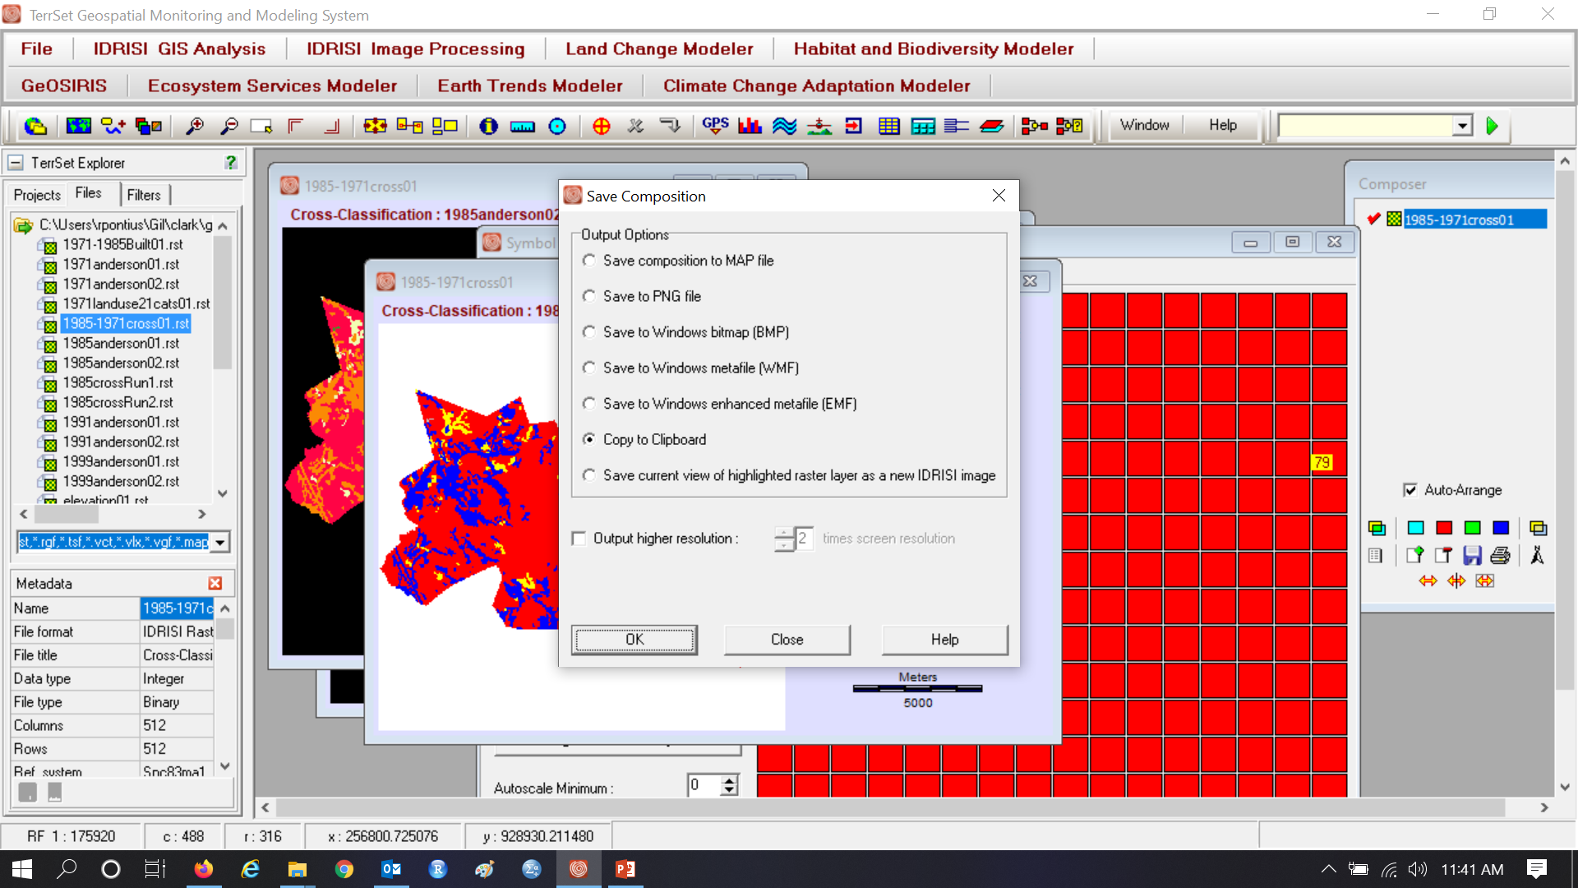
Legend, Pallete, Scale Bar, & North Arrow

Slide 57
Now realize you have an error in the legend

Slide 58
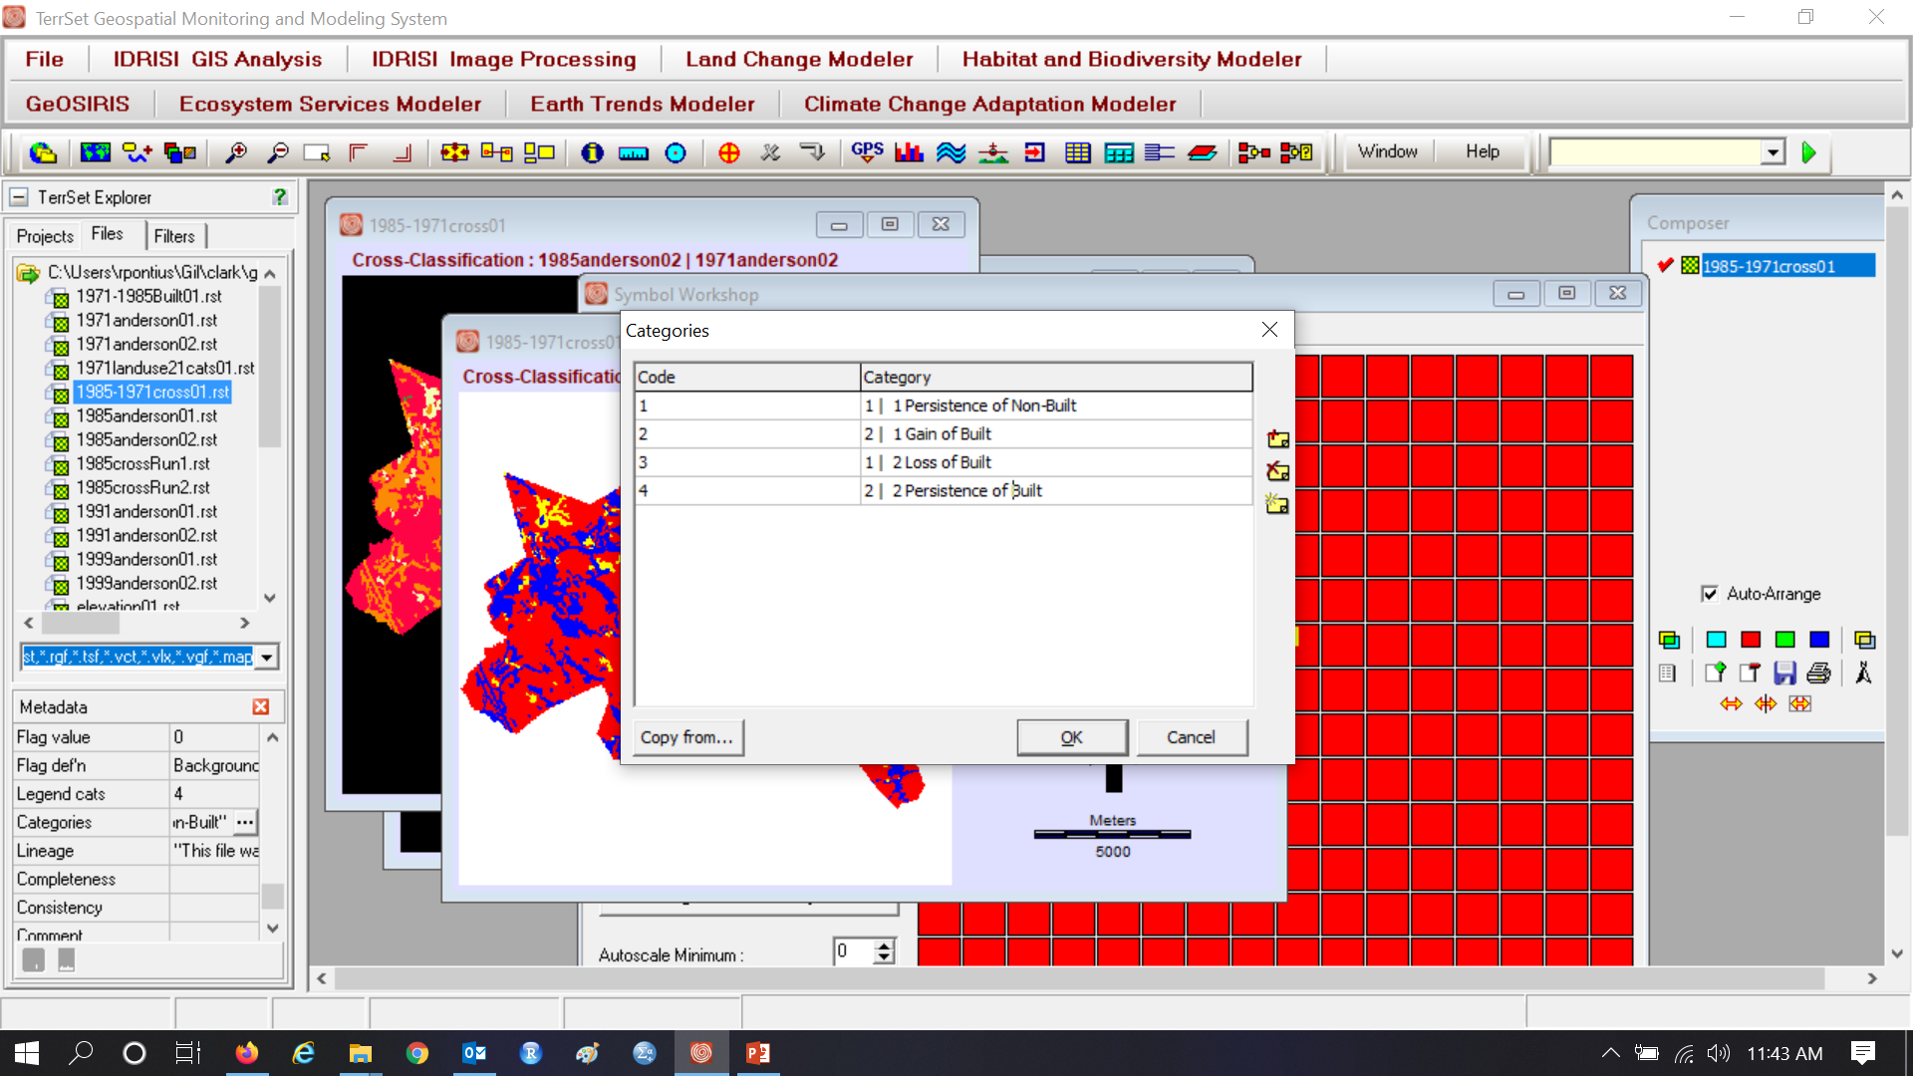
Legend, Pallete, Scale Bar, & North Arrow

Slide 59
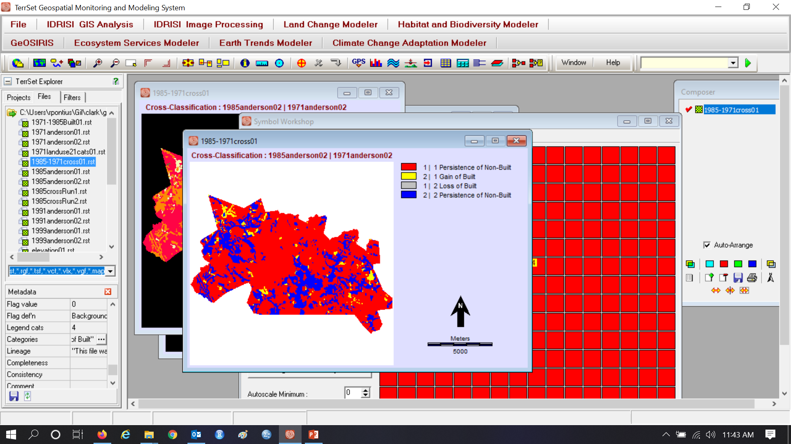
Remember to click save in the lower left

Slide 60
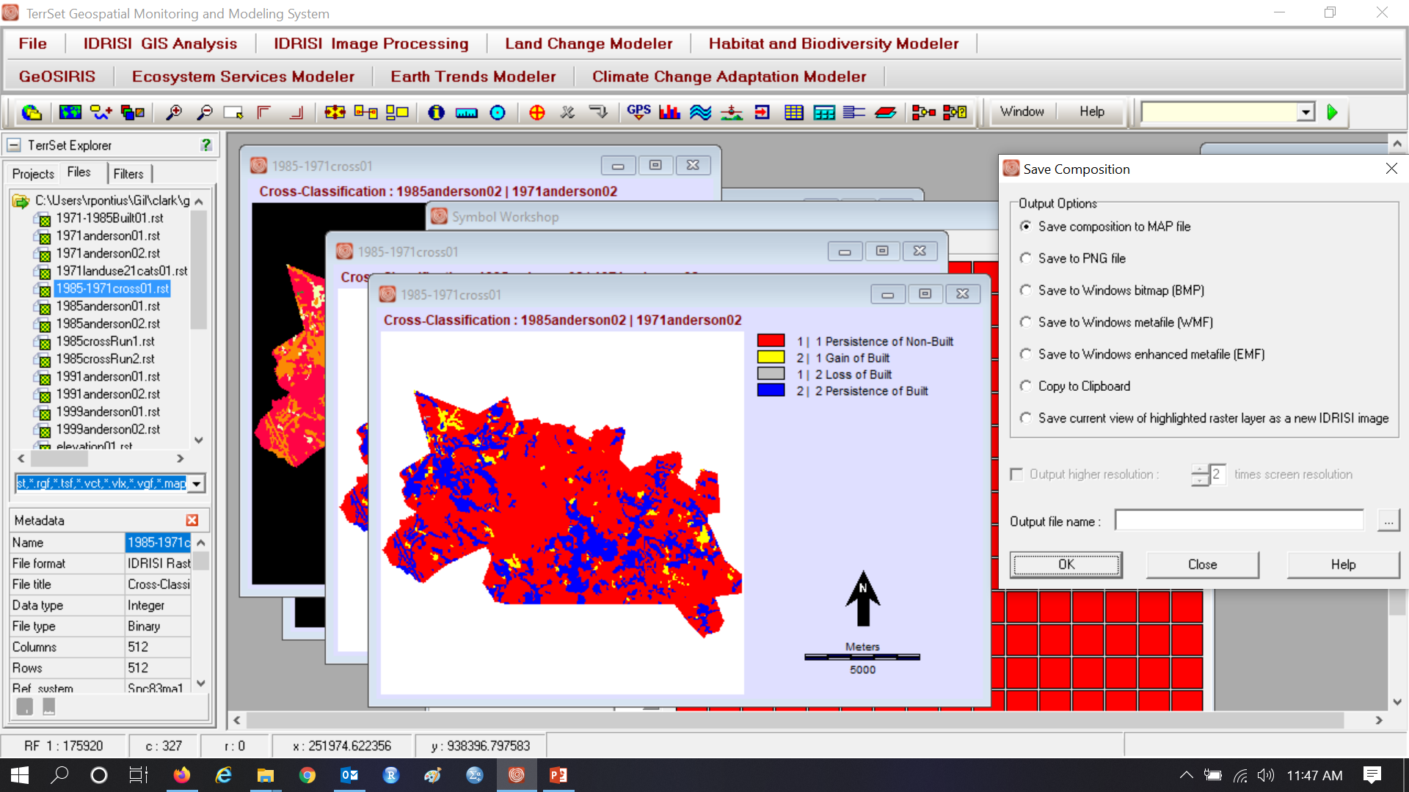
It would have been good to save a MAP file

Slide 61
Beautiful!!

